Slide 1
Using Data-Inspired Content Pillars to Elevate Your Content Marketing
Brian Piper
Director of Content Strategy and Assessment
University of Rochester
brianwpiper.com • @brianwpiper • #CMWorld

Slide 2
getmyslides.info
brianwpiper.com • @brianwpiper • #CMWorld

Slide 3
What are content pillars?
Organizational method
Strategic alignment
Notes:
When we talk about content pillars, or some people call them content categories, or content buckets, what we’re talking about are ways to organize your content.
Help create strategic alignment within your content and make it easier for your visitors to understand your areas of focus and expertise.
They are not topic areas (education, training, inspiration) or series (Marketing Monday, or quick tip Tuesday)
1 pillar – niche, 10 pillars – too fragmented (3-7 ideally)
Most obvious things you think about your business
What your customer needs for their business
Know, like, trust

Slide 4
Why content pillars?
Easier navigation for users
Easier indexing for search
Easier method for focusing content strategy
Sends a message to social algorithms

Slide 5
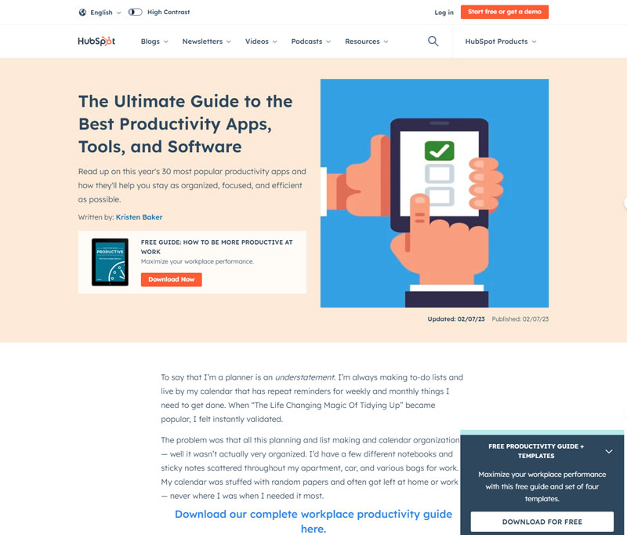
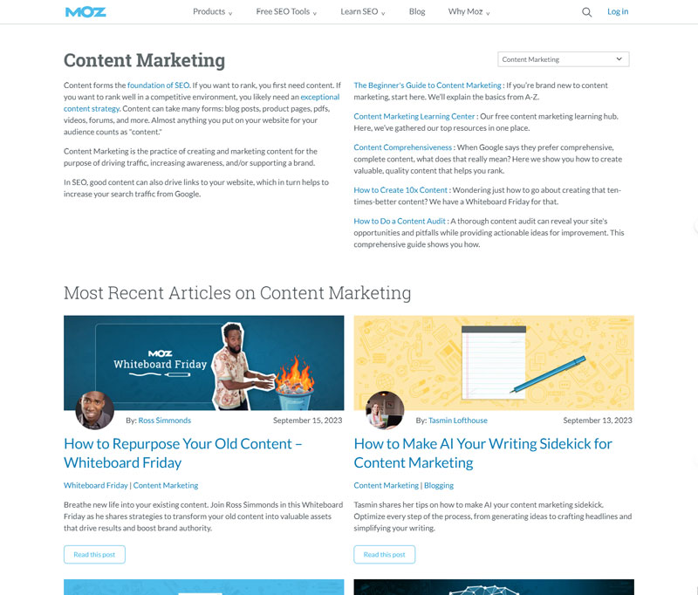
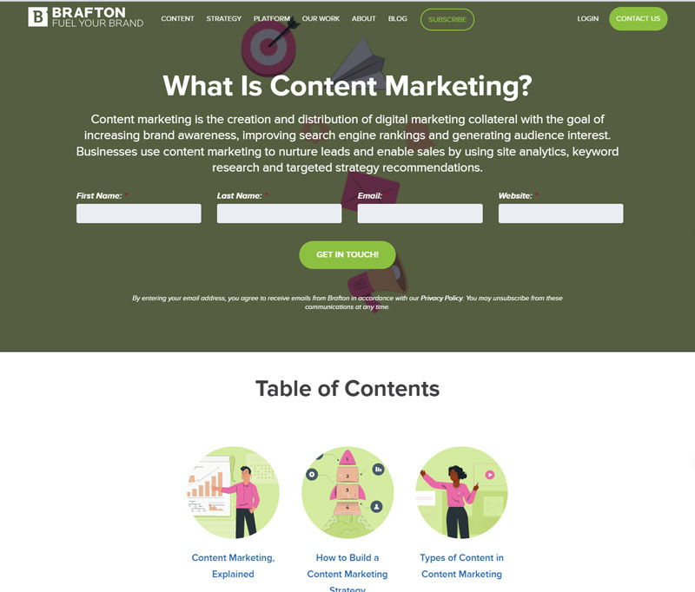
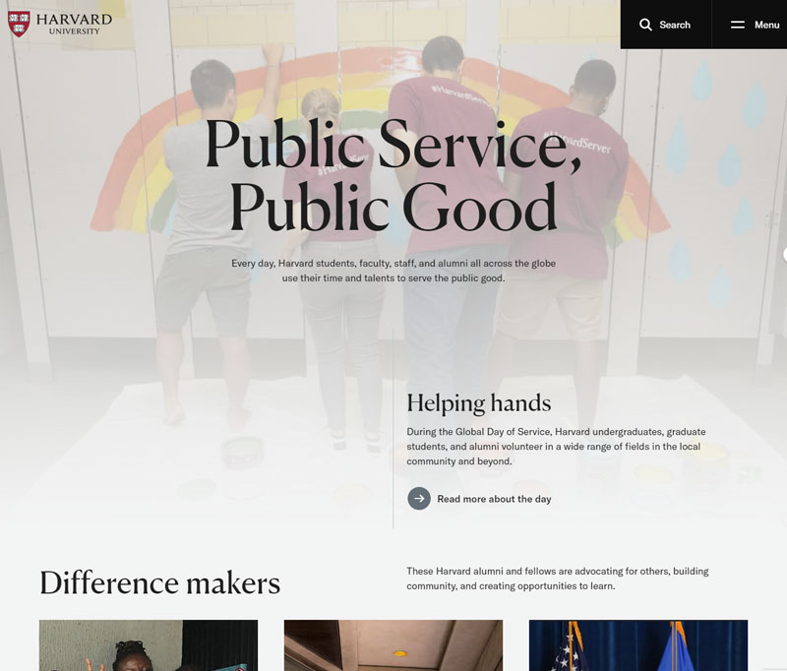
Who is doing this well?

Slide 6
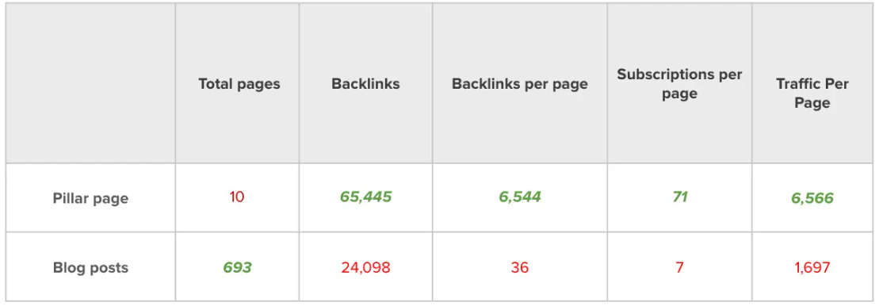
Why content pillars?
Notes:
Brafton

Slide 7
Why content pillars?
Notes:
HubSpot

Slide 8
DISCOVERABILITY
Notes:
Content pillars work on your websites, on social, in videos, wherever you create content.
It all comes down to one key factor. To the most critical issue for all of us…discoverability.

Slide 9
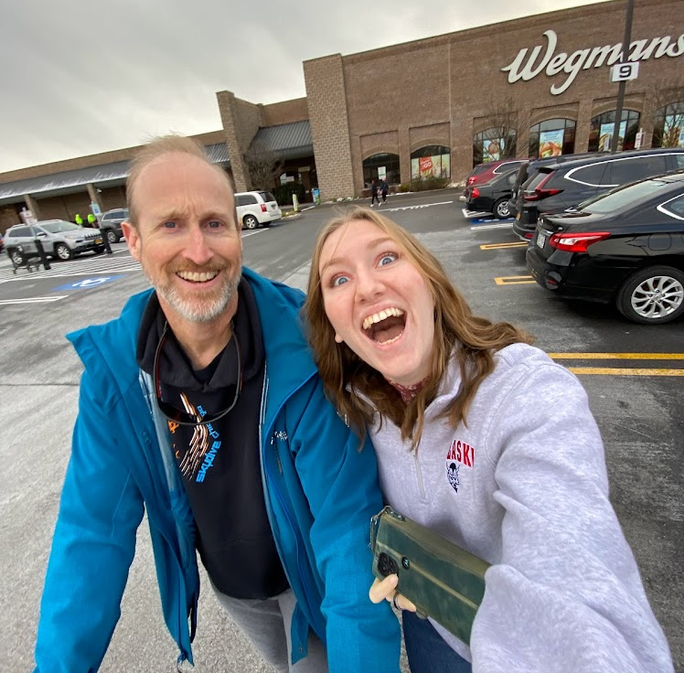
brianwpiper.com • @brianwpiper • #CMWorld

Slide 10
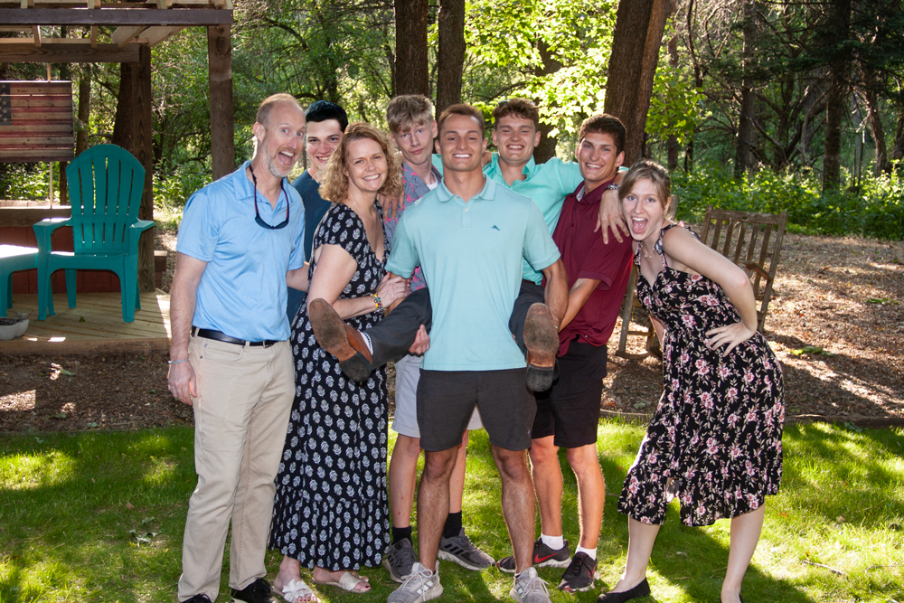
brianwpiper.com • @brianwpiper • #CMWorld

Slide 11
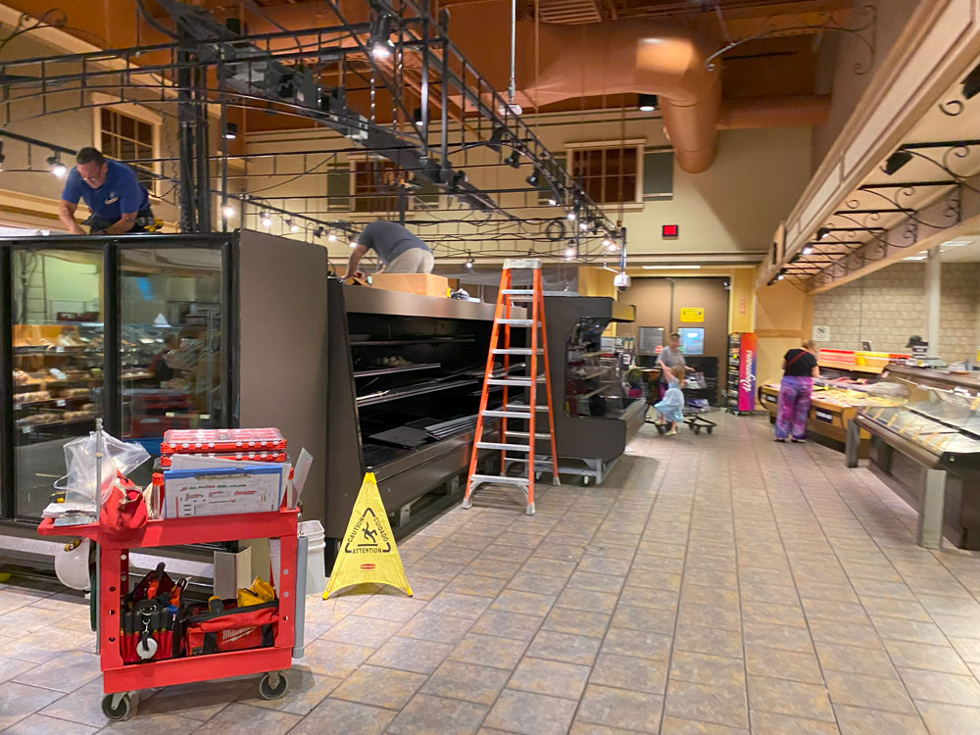
brianwpiper.com • @brianwpiper • #CMWorld

Slide 12
brianwpiper.com • @brianwpiper • #CMWorld

Slide 13
brianwpiper.com • @brianwpiper • #CMWorld

Slide 14
brianwpiper.com • @brianwpiper • #CMWorld

Slide 15
brianwpiper.com • @brianwpiper • #CMWorld

Slide 16
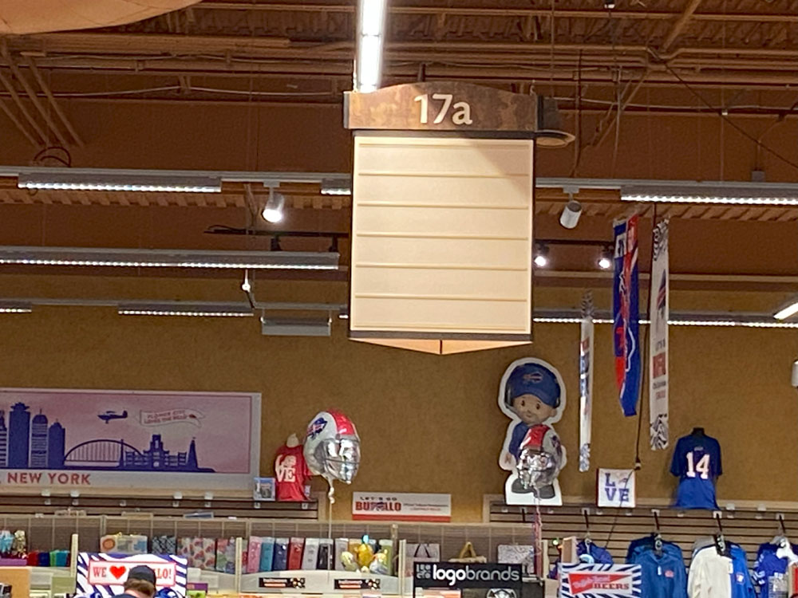
brianwpiper.com • @brianwpiper • #CMWorld

Slide 17
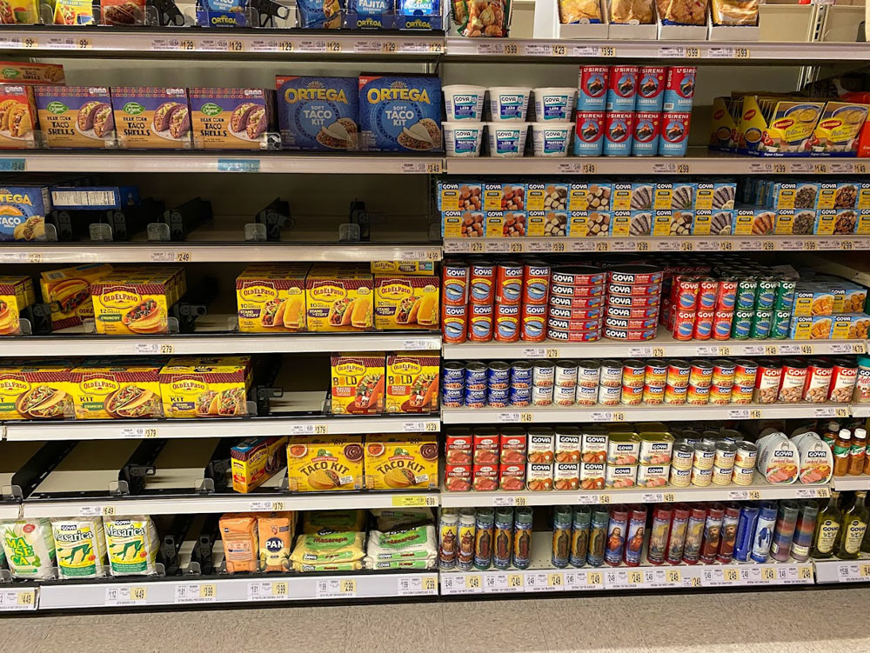
brianwpiper.com • @brianwpiper • #CMWorld

Slide 18
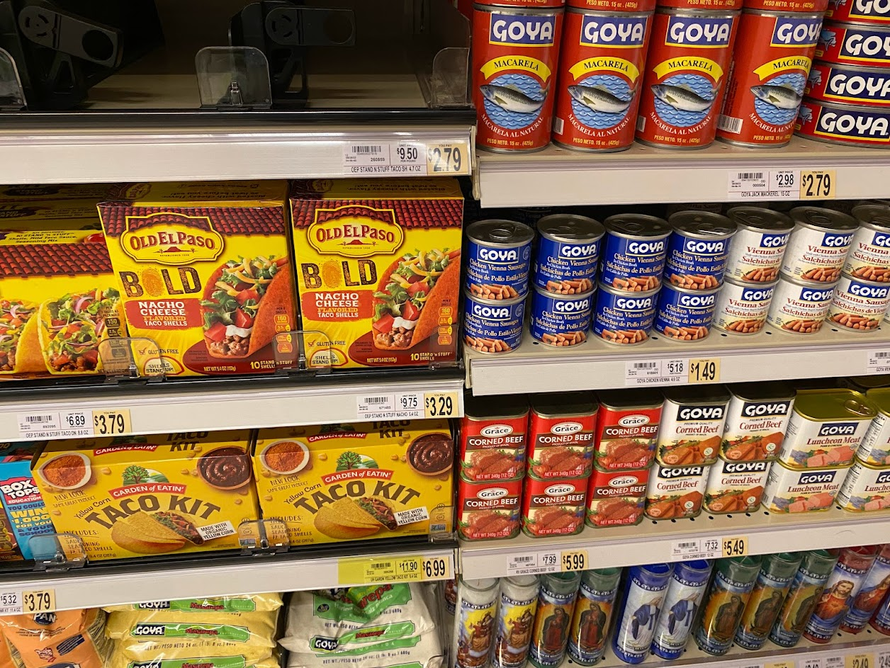
brianwpiper.com • @brianwpiper • #CMWorld
Notes:
That’s the thing about discoverability…it builds trust

Slide 19
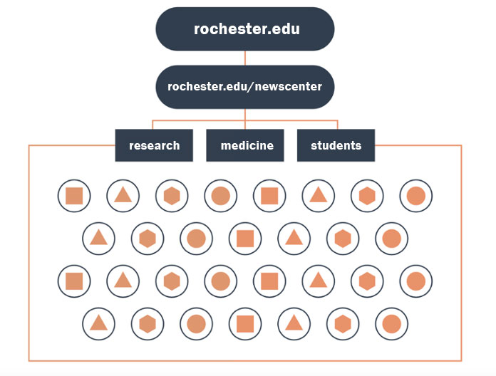
Typical IA

Slide 20
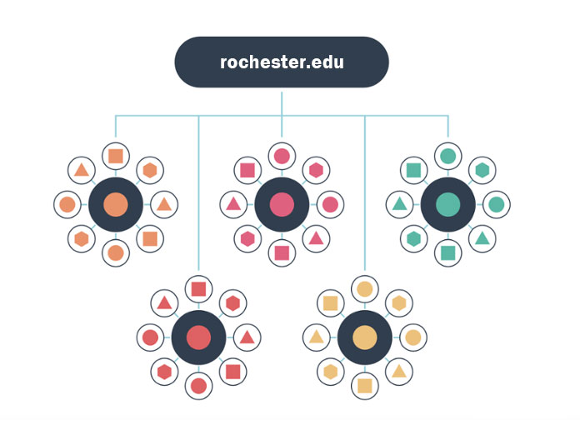
Pillar pages

Slide 21
Pillar pages

Slide 22
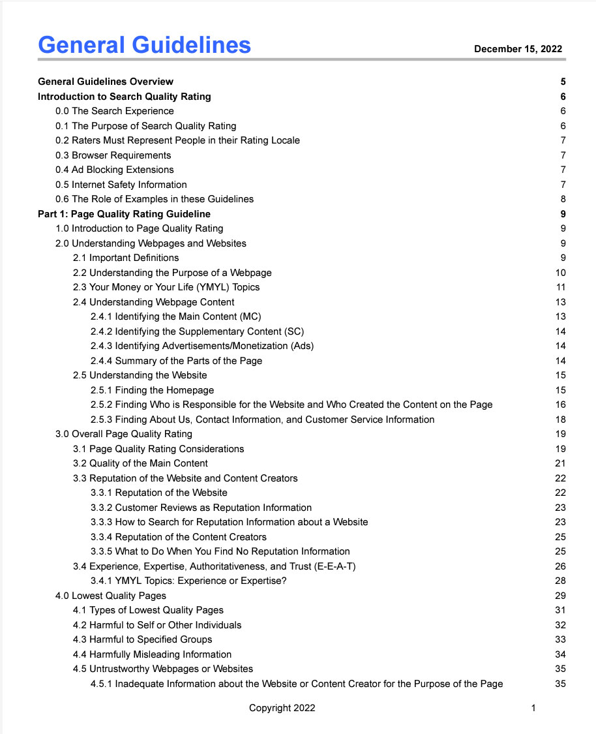
Search Quality
Evaluator Guidelines
Notes:
126 times in a 176 page document

Slide 23
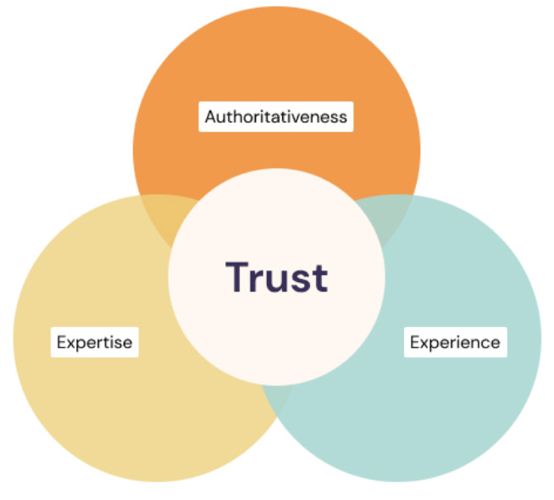
EEAT
Notes:
EEAT stands for experience, expertise, authoritativeness, and trust.
Does the creator or source of the content have first-hand or life experience with the topic?
Do they have the necessary knowledge or skill for the topic, the expertise?
Are they an authority? Are they a go-to source for the topic?
Those three factors, along with a few other factors, all go into establishing the overall trust level for the site and trust is the most important part of the EEAT factor.
We have a lot working for us as an institution. But one of the things that help Google and evaluators identify your site as high EEAT is having a breadth of content around a particular topic area.

Slide 24
Identify pillars
Pick the most strategic terms

Slide 25
Identify pillars
Pick the most strategic terms
TALK TO YOUR CUSTOMERS!!
Understand their problems
Learn their questions
Explore their journeys
Search intent

Slide 26
Identify pillars
Pick the most strategic terms
TALK TO YOUR CUSTOMERS!!
Understand their problems
Learn their questions
Explore their journeys
Search intent
Look at the data

Slide 27
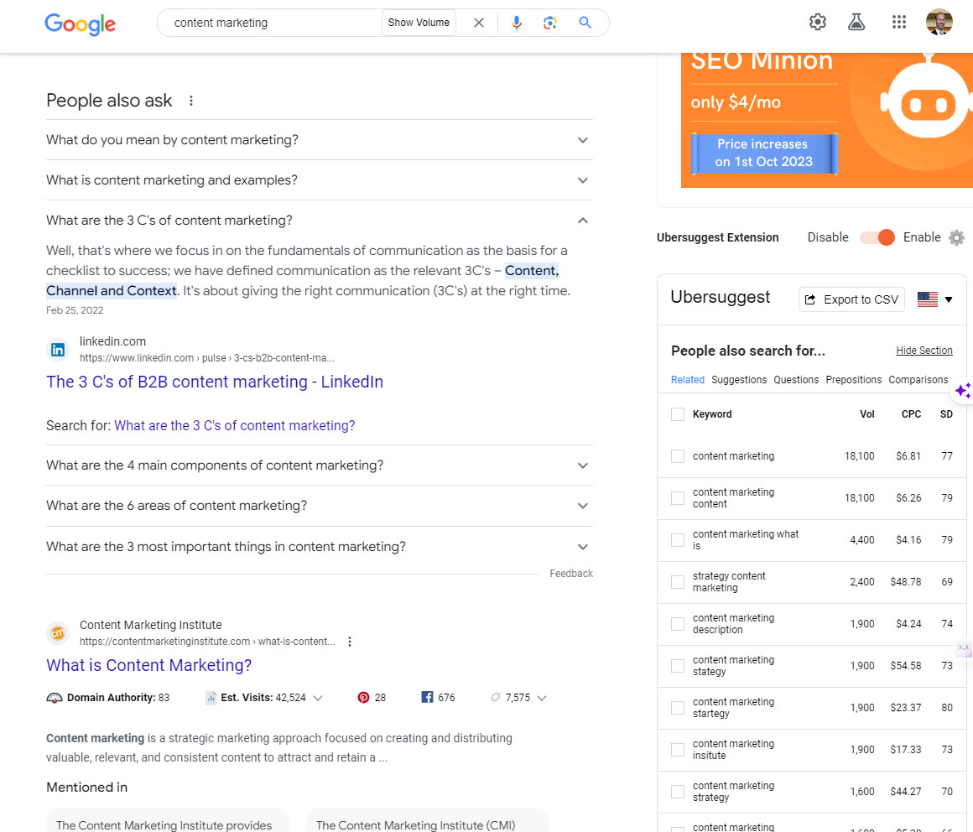
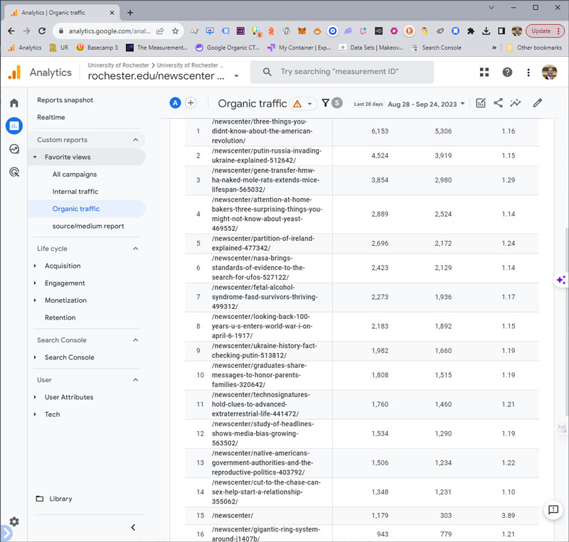
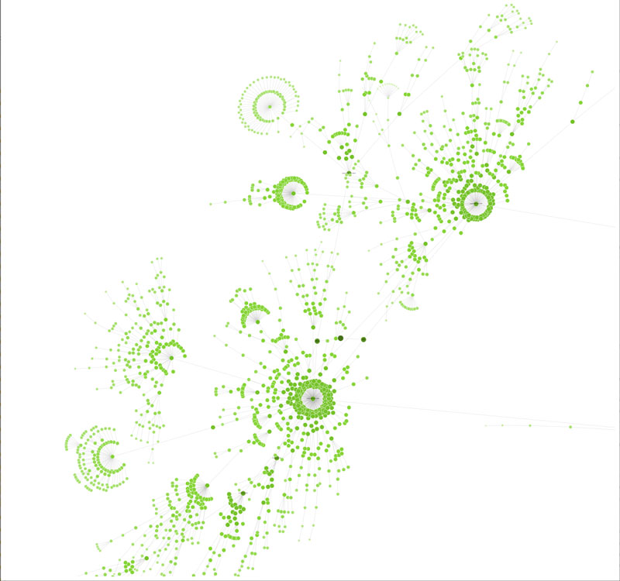
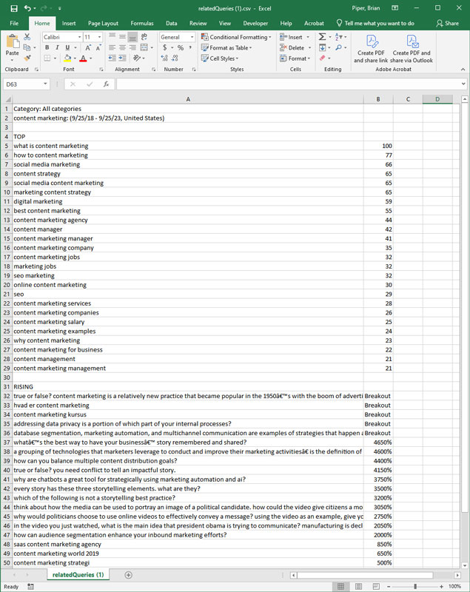
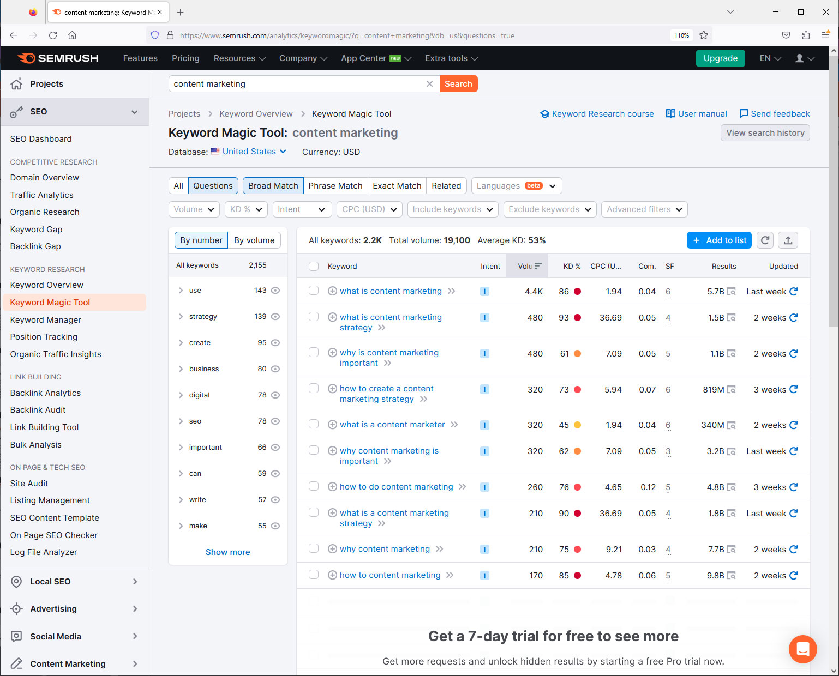
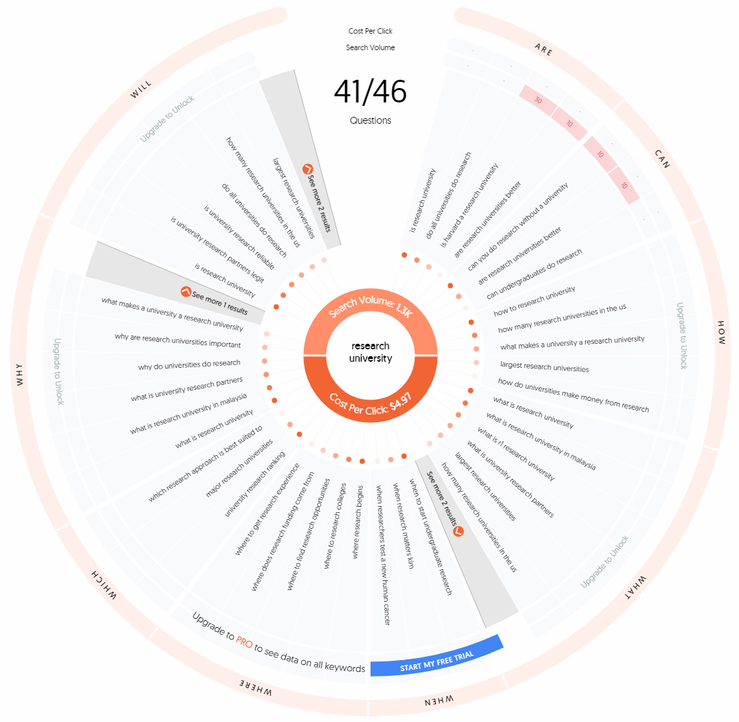
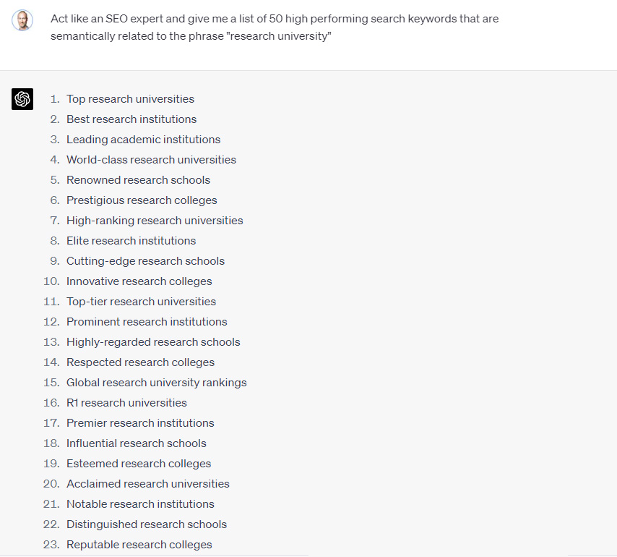
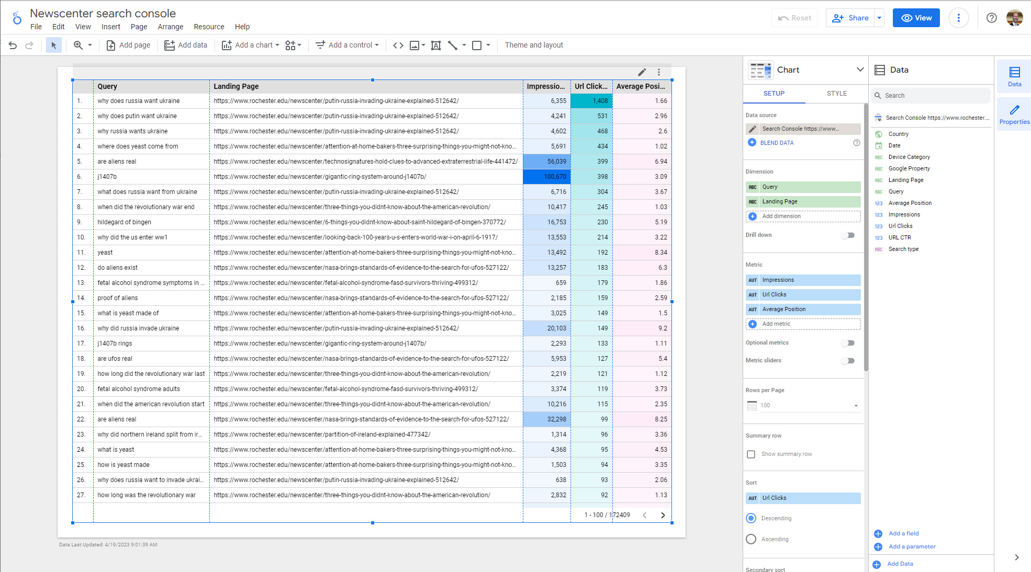
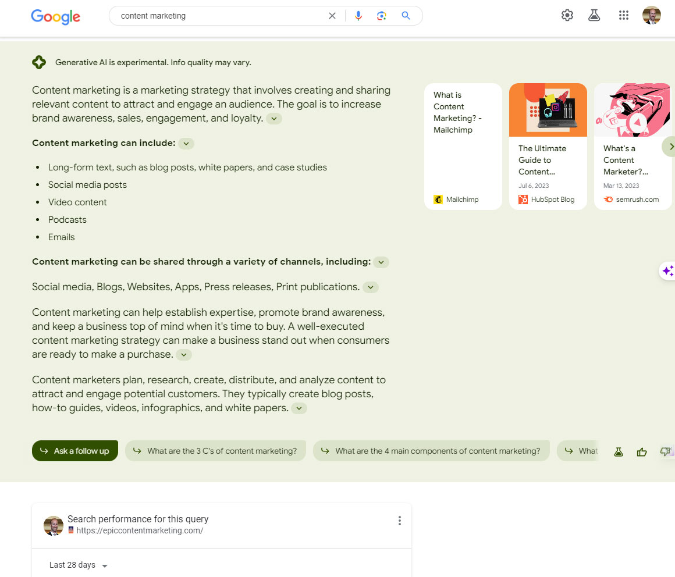
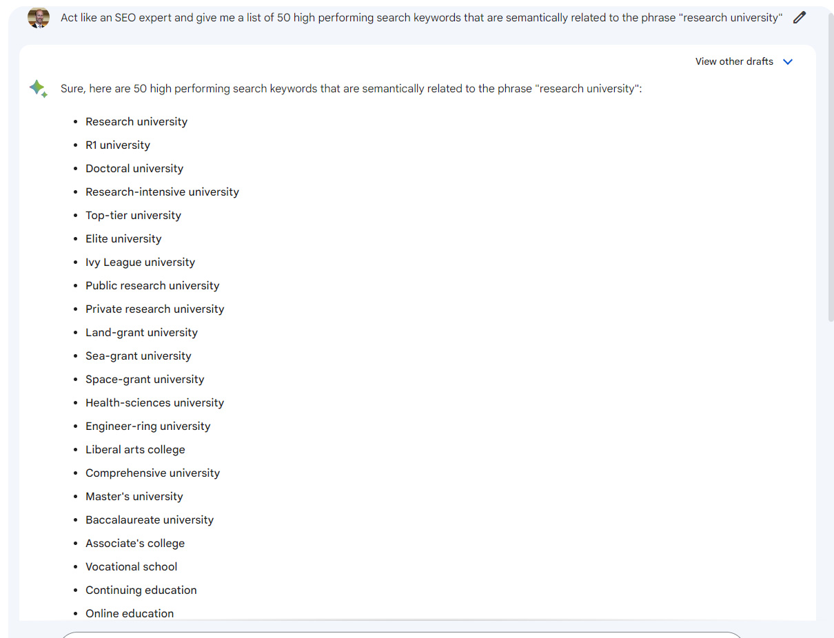
Research
Google trends
Google search (PAA and SGE)
AnswerThePublic.com
MOZ/Semrush/aHrefs
Google Analytics
Google Search Console/ Looker Data Studio
Information Architecture
AI – semantic terms

Slide 28
The process
Strategic plan

Slide 29
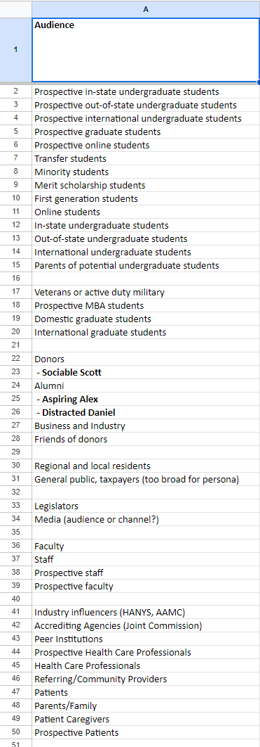
The process
Strategic plan
Audience and intent research

Slide 30
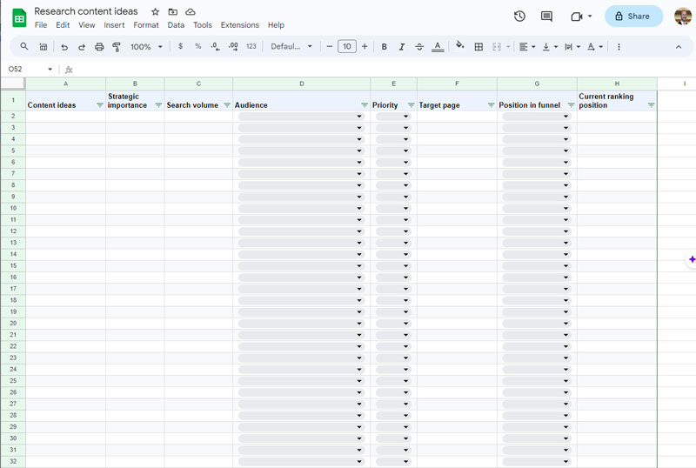
The process
Strategic plan
Audience and intent research
Brainstorm

Slide 31
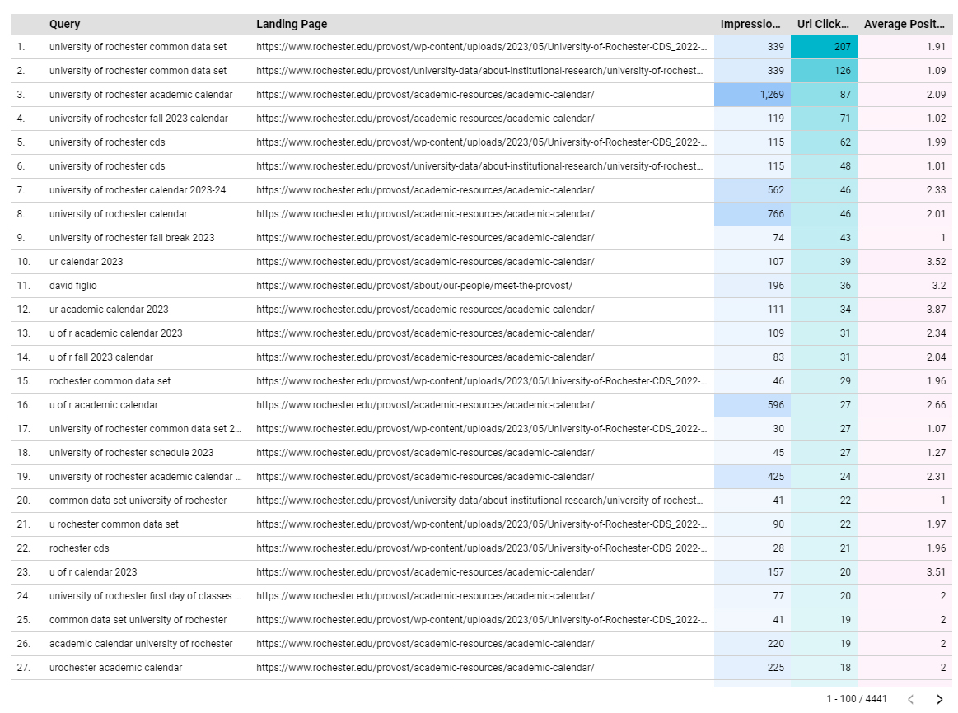
The process
Strategic plan
Audience and intent research
Brainstorm
Analytics/Search console

Slide 32
The process
Strategic plan
Audience and intent research
Brainstorm
Analytics/Search console
Answer the public

Slide 33
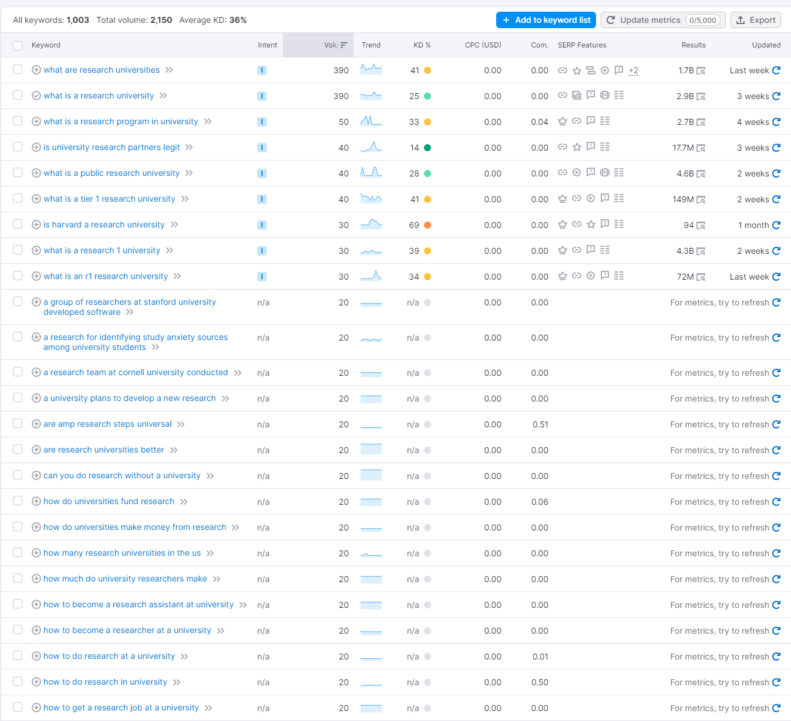
The process
Strategic plan
Audience and intent research
Brainstorm
Analytics/Search console
Answer the public
Semrush/Moz/aHrefs/AI

Slide 34
The process
Strategic plan
Audience and intent research
Brainstorm
Analytics/Search console
Answer the public
Semrush/Moz/aHrefs/AI
Pillars and content

Slide 35
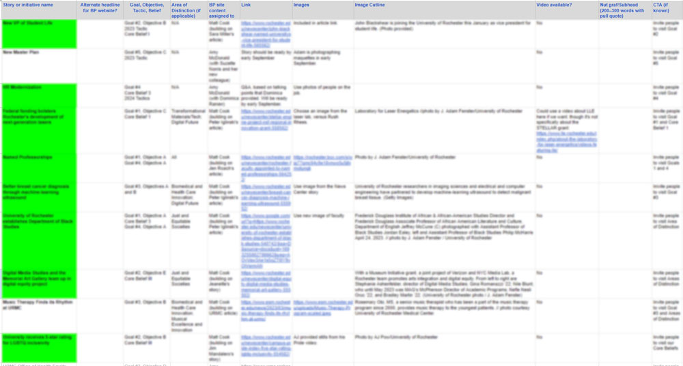
The process
Strategic plan
Audience and intent research
Brainstorm
Analytics/Search console
Answer the public
Semrush/Moz/aHrefs/AI
Pillars and content
Links

Slide 36
The process
Strategic plan
Audience and intent research
Brainstorm
Analytics/Search console
Answer the public
Semrush/Moz/aHrefs/AI
Pillars and content
Links
Publish in batches

Slide 37
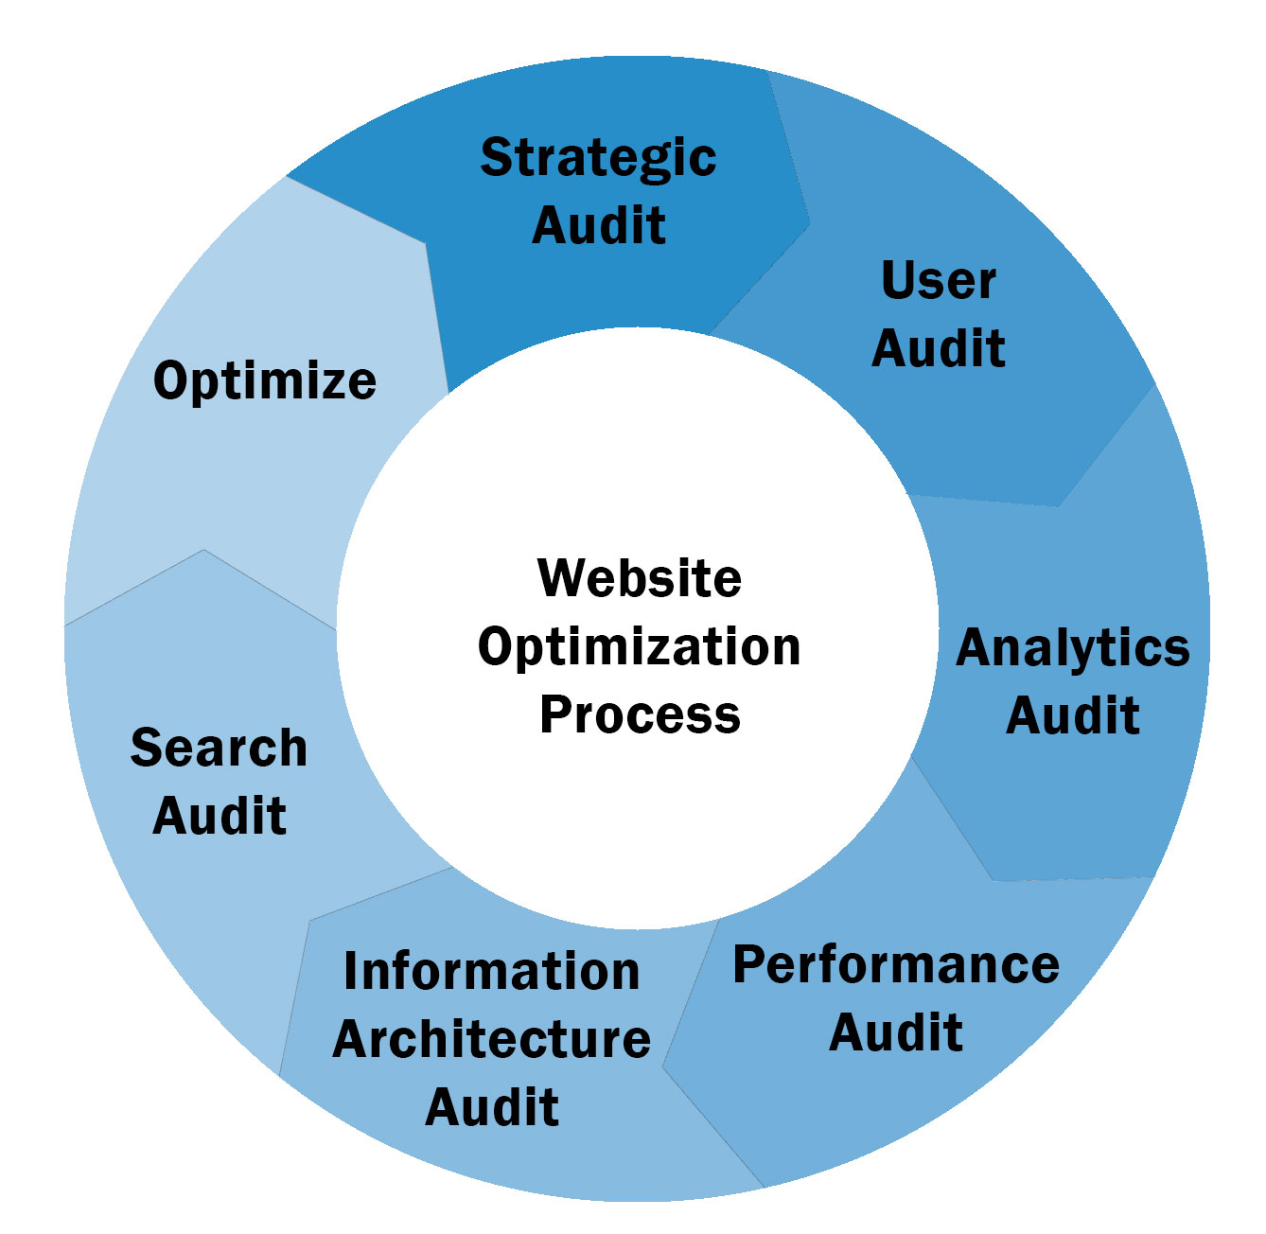
The process
Strategic plan
Audience and intent research
Brainstorm
Analytics/Search console
Answer the public
Semrush/Moz/aHrefs/AI
Pillars and content
Links
Publish in batches
Optimize

Slide 38
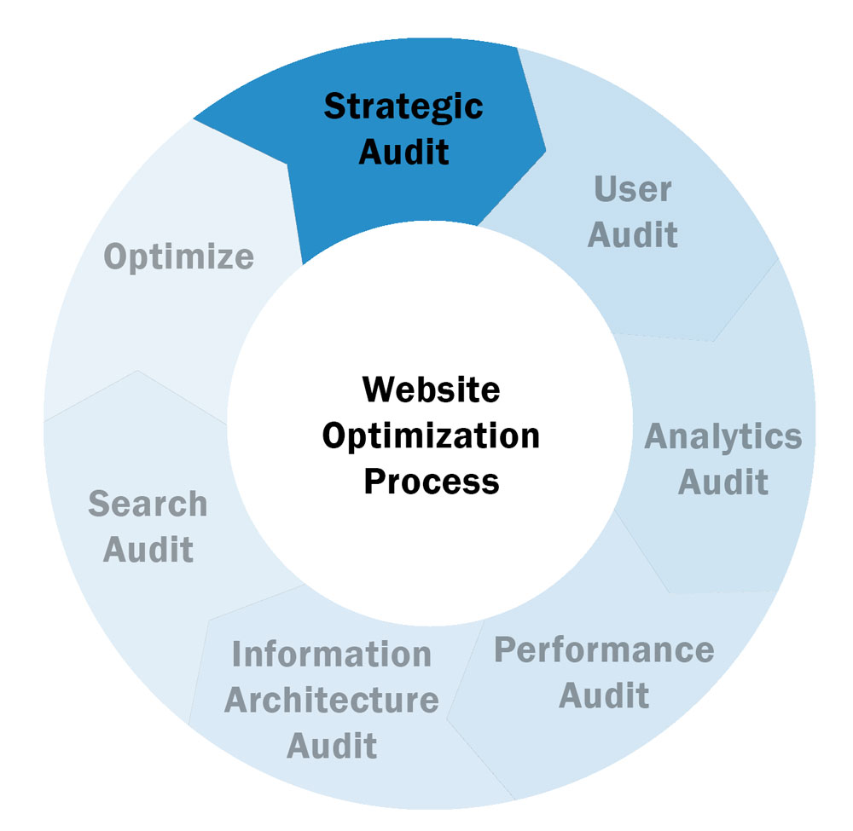
The process
Strategic plan
Audience and intent research
Brainstorm
Analytics/Search console
Answer the public
Semrush/Moz/aHrefs/AI
Pillars and content
Links
Publish in batches
Optimize

Slide 39
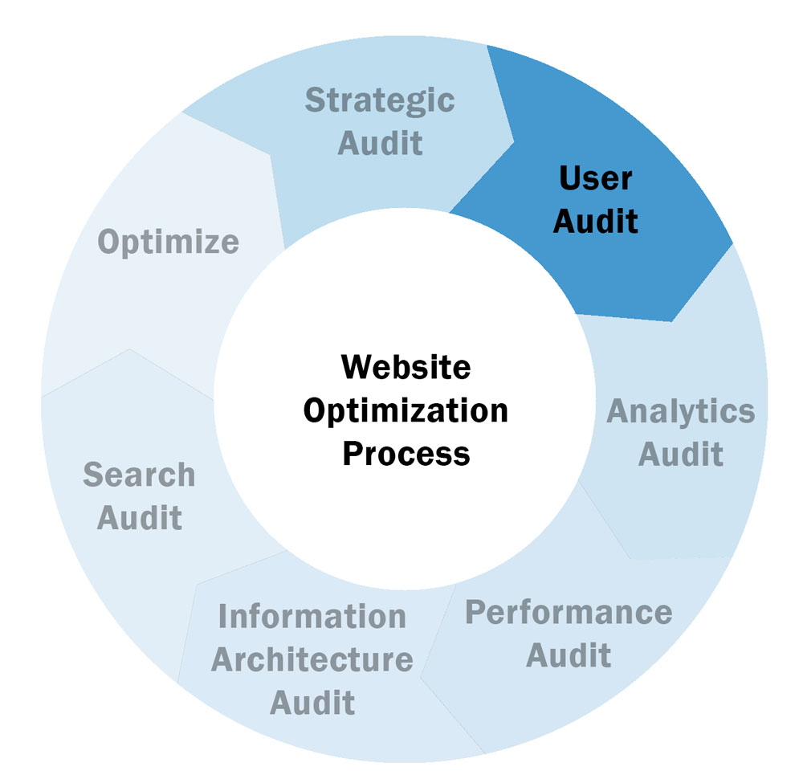
The process
Strategic plan
Audience and intent research
Brainstorm
Analytics/Search console
Answer the public
Semrush/Moz/aHrefs/AI
Pillars and content
Links
Publish in batches
Optimize

Slide 40
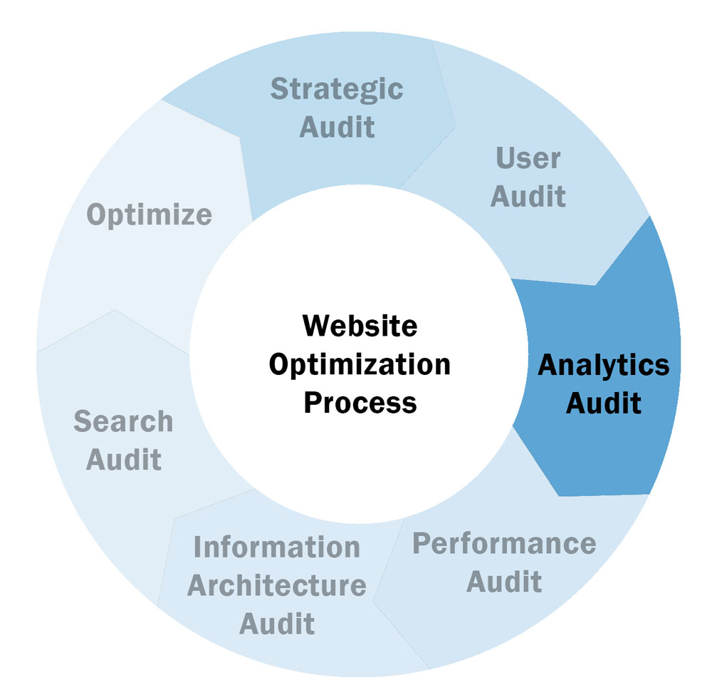
The process
Strategic plan
Audience and intent research
Brainstorm
Analytics/Search console
Answer the public
Semrush/Moz/aHrefs/AI
Pillars and content
Links
Publish in batches
Optimize

Slide 41
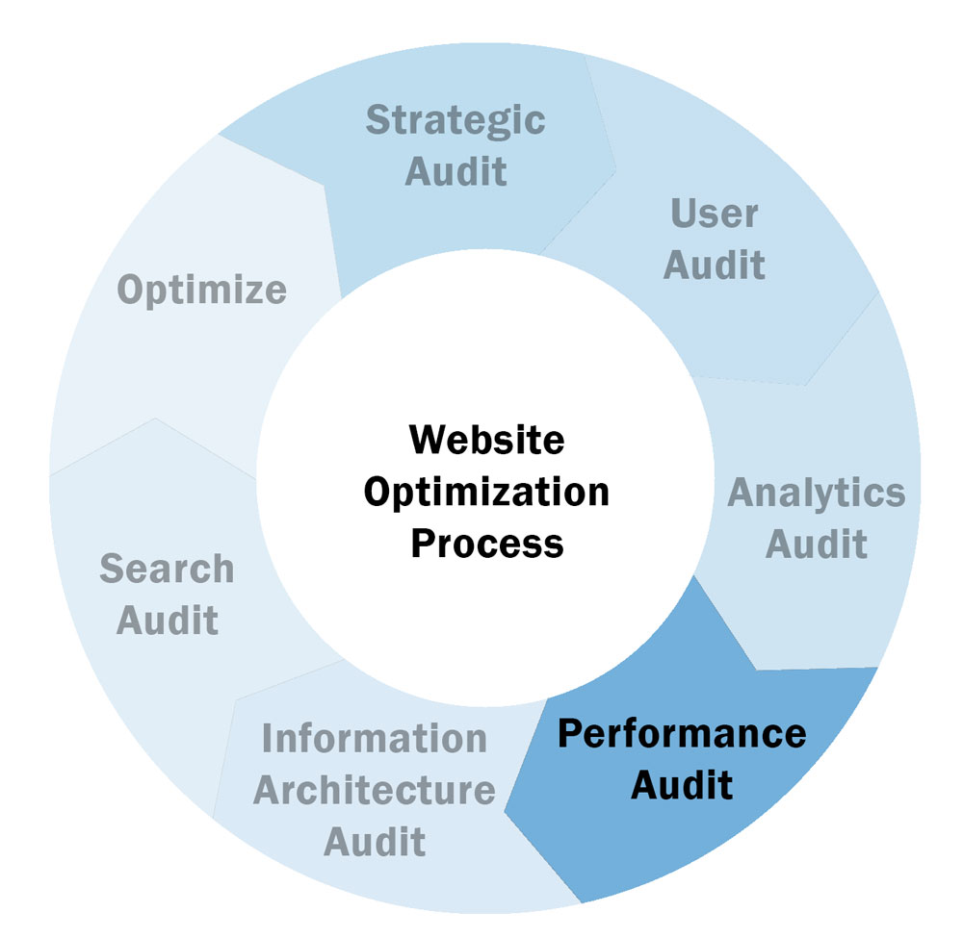
The process
Strategic plan
Audience and intent research
Brainstorm
Analytics/Search console
Answer the public
Semrush/Moz/aHrefs/AI
Pillars and content
Links
Publish in batches
Optimize

Slide 42
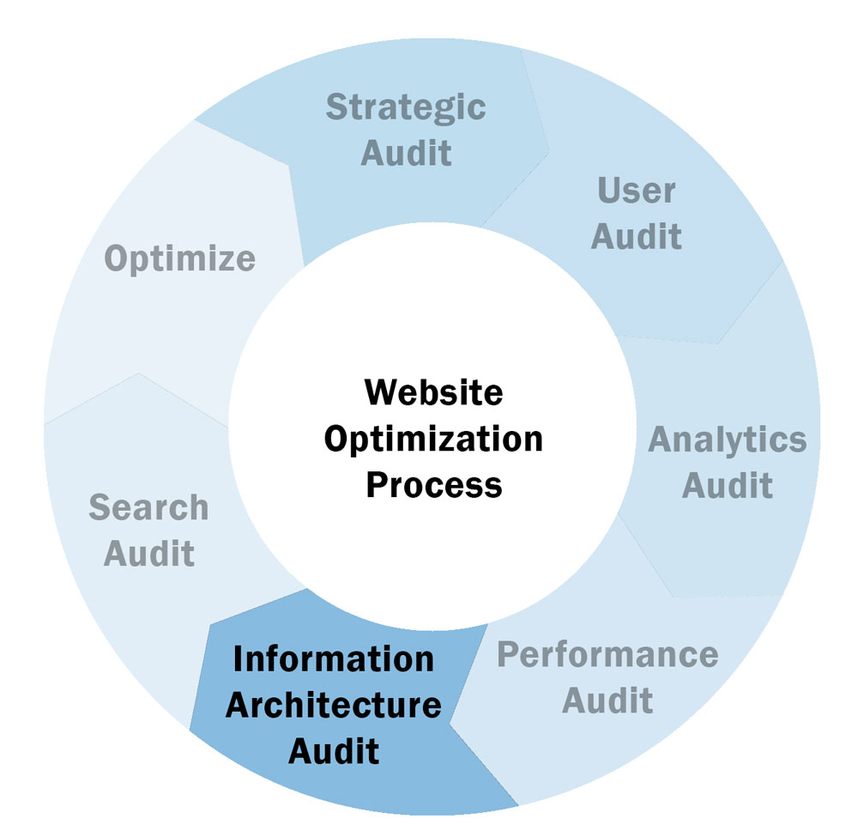
The process
Strategic plan
Audience and intent research
Brainstorm
Analytics/Search console
Answer the public
Semrush/Moz/aHrefs/AI
Pillars and content
Links
Publish in batches
Optimize

Slide 43
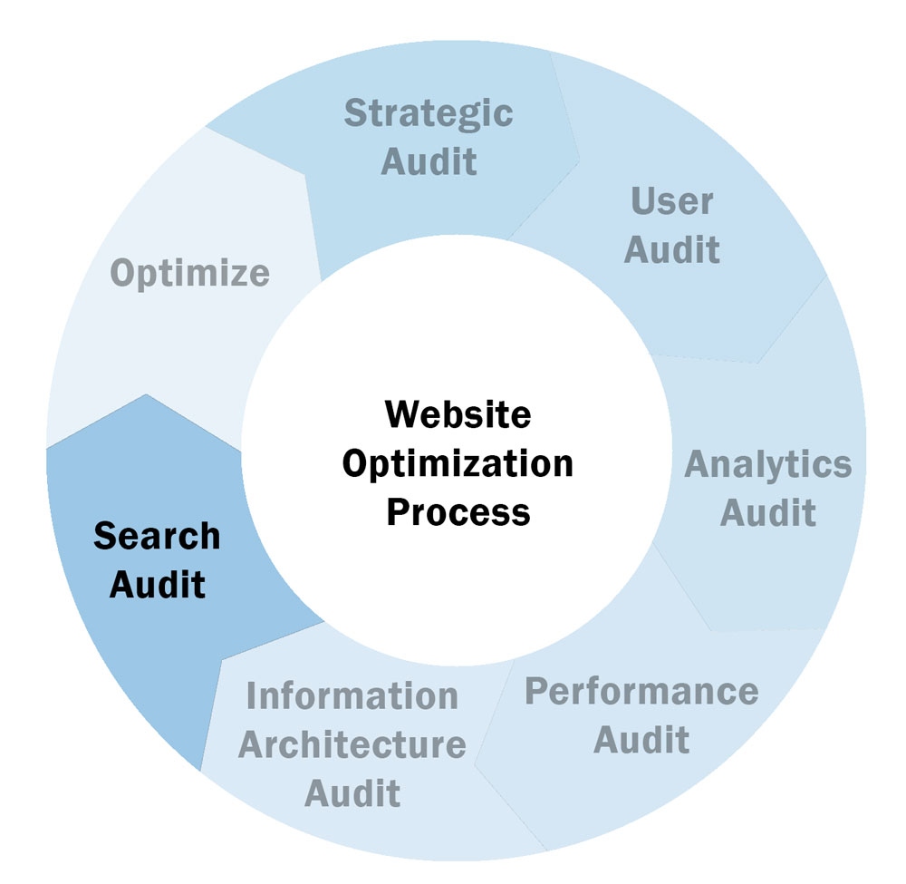
The process
Strategic plan
Audience and intent research
Brainstorm
Analytics/Search console
Answer the public
Semrush/Moz/aHrefs/AI
Pillars and content
Links
Publish in batches
Optimize

Slide 44
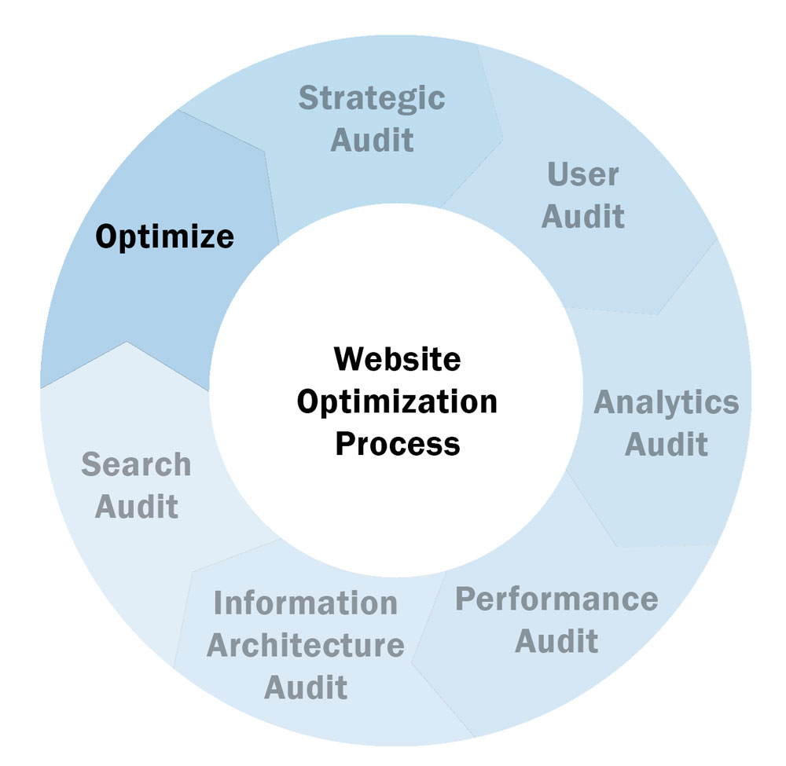
The process
Strategic plan
Audience and intent research
Brainstorm
Analytics/Search console
Answer the public
Semrush/Moz/aHrefs/AI
Pillars and content
Links
Publish in batches
Optimize

Slide 45
Questions?
Brian Piper
bpiper2@ur.rochester.edu
https://www.linkedin.com/in/brianwpiper/
Speaking, workshops, consulting, newsletter
SEO, AI, content marketing/optimization,
data analytics, web3
Getmyslides.info
brianwpiper.com • @brianwpiper • #CMWorld

