Slide 1
Using Epic Content Marketing in Higher Education

Slide 2
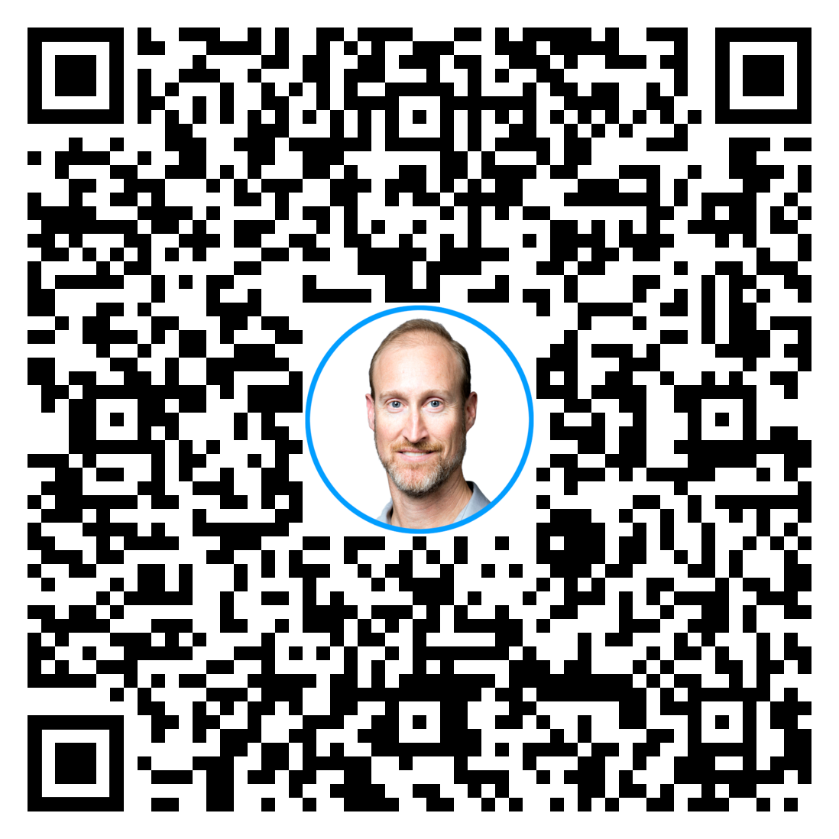
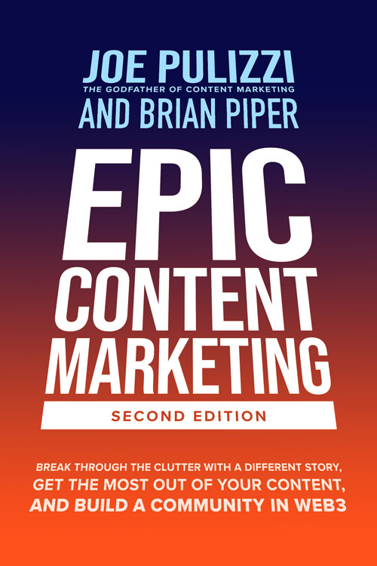
Brian Piper
Director of Content Strategy and Assessment
University of Rochester
Rochester, NY
bpiper2@ur.rochester.edu
https://brianwpiper.com/
GetMySlides.info

Slide 3
CONTENT

Slide 4
What is your favorite book?

Slide 5
“You don’t need to be the biggest or the best. You need to be their favorite.”
– Jay Acunzo

Slide 6
What is content marketing?
Content marketing is the marketing and business process for creating and distributing valuable and compelling content to attract, acquire, and
engage a clearly defined and understood target audience—with the objective of driving profitable customer action.

Slide 7
DON’T FORGET!!
CUSTOMERS DON’T CARE ABOUT YOUR PRODUCTS OR YOUR SERVICES!

Slide 8
Content focus
Inform/educate
Entertain
Edutainment

Slide 9
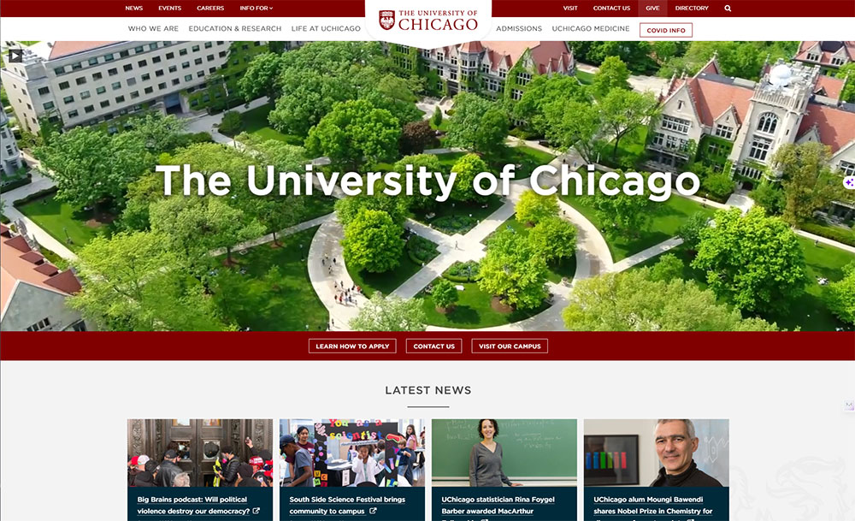

Slide 10
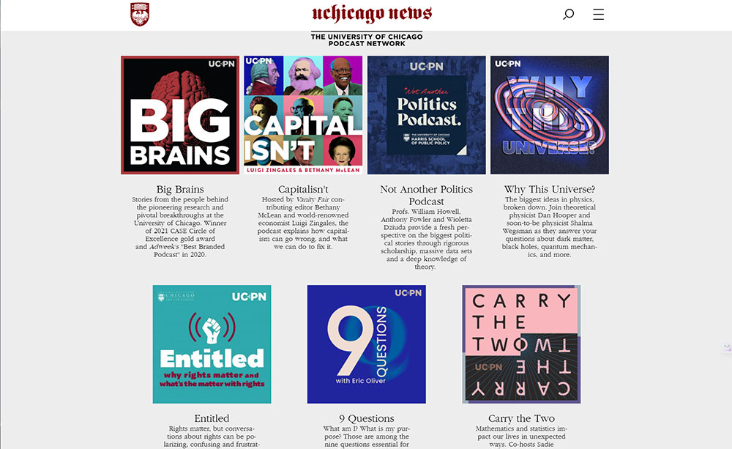

Slide 11
“When we created Big Brains, we saw podcasts as a unique opportunity to highlight the world-changing research of UChicago scholars in an engaging way. We hope each episode feels like a dinner party conversation, in which people of all ages can learn about the impact of this important work.”
- Paul M. Rand, UChicago’s vice president for communications and host of Big Brains.

Slide 12
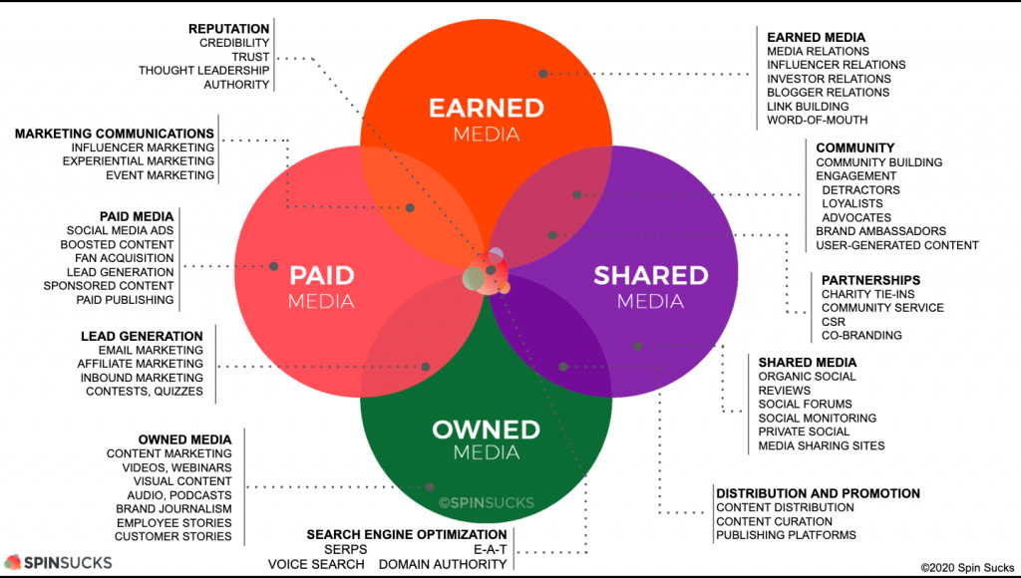
Why content marketing?

Slide 13
Principles of content marketing
Fill a need
Be consistent
Be human
Have a point of view
Avoid “sales speak”
Be best of breed

Slide 14
The content marketing process
Identifying the goal or objective
Defining the audience
Understanding how the audience decides
Choosing your content niche
Developing your content marketing mission statement

Slide 15
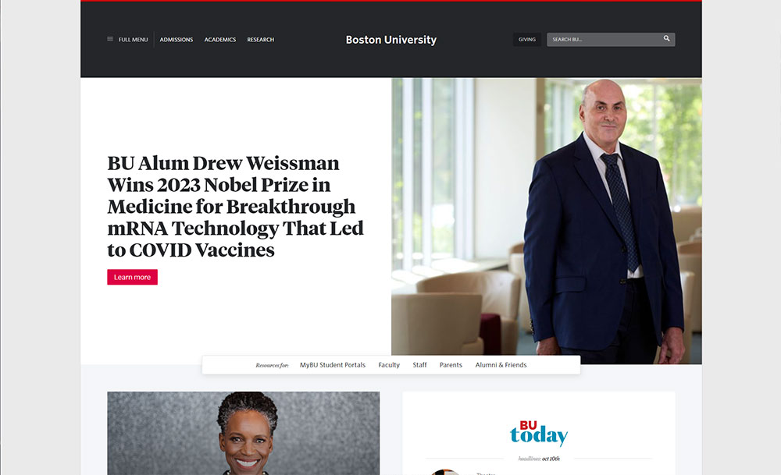

Slide 16
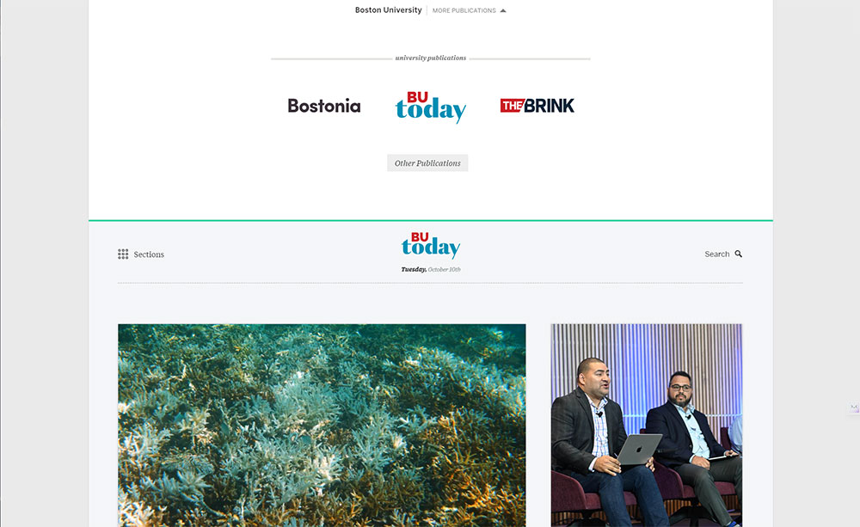

Slide 17
Content as an asset
Content has long-term value
Typical article – 700-1,500 pageviews
High Performer – 30,000 pageviews in 3 years

Slide 18
Content as an asset
Content has long-term value
Content creates content

Slide 19
Audience
“I am not the target for my content.”

Slide 20
Personas
Priority initiatives
Success factors
Perceived barriers
Decision criteria
Decision process/journey

Slide 21
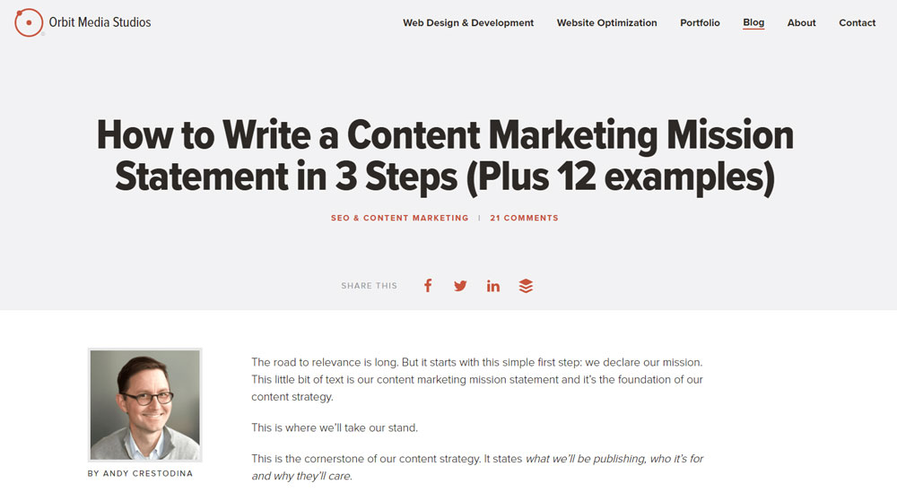
Content marketing mission statement
“Our institution is where [audience X] finds [content Y] for [benefit Z].”

Slide 22
Content marketing mission statement
Epic content marketing is impossible without a clear and formidable why

Slide 23
Owned land vs. rented land

Slide 24
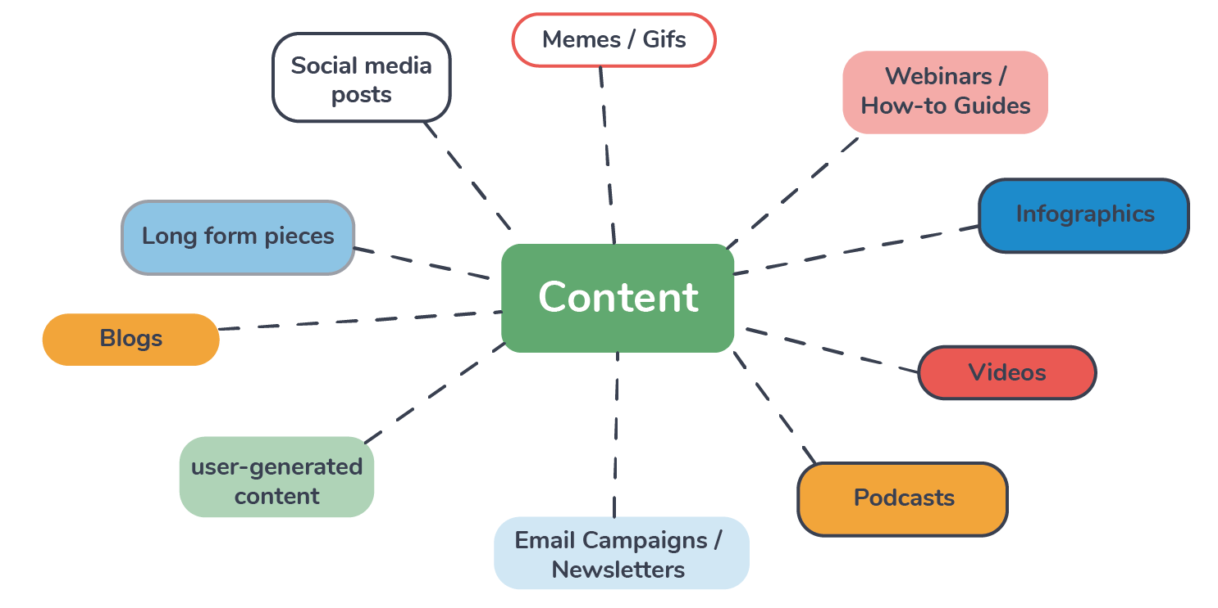
Content types and channels

Slide 25
Content types and channels
Start with one…

Slide 26
Content promotion

Slide 27
Content performance and optimization
Look at your data

Slide 28
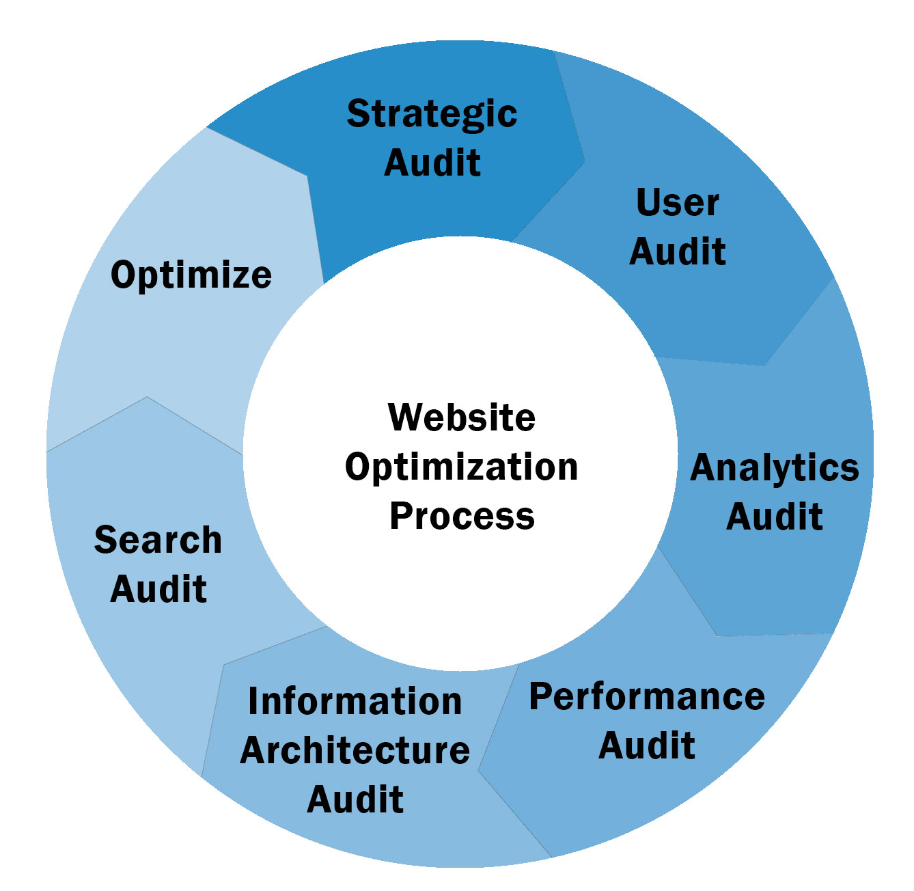

Slide 29
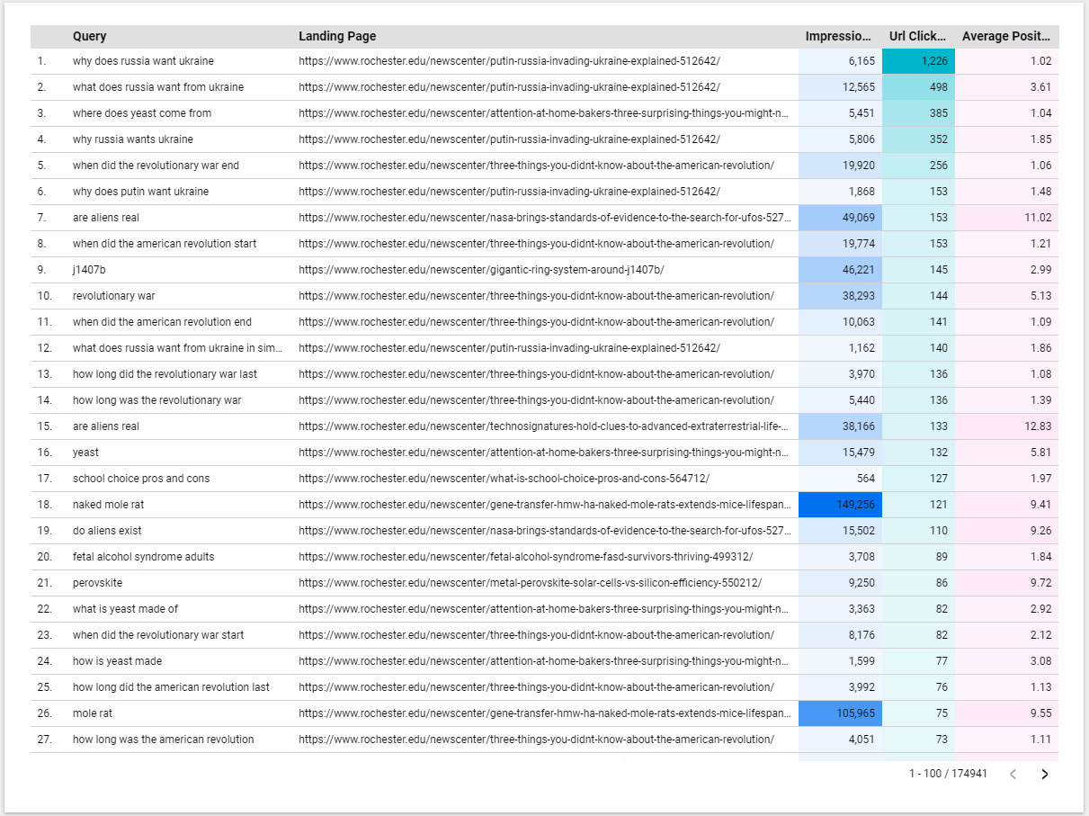
Reactive
Google Search Console/Looker Data Studio

Slide 30
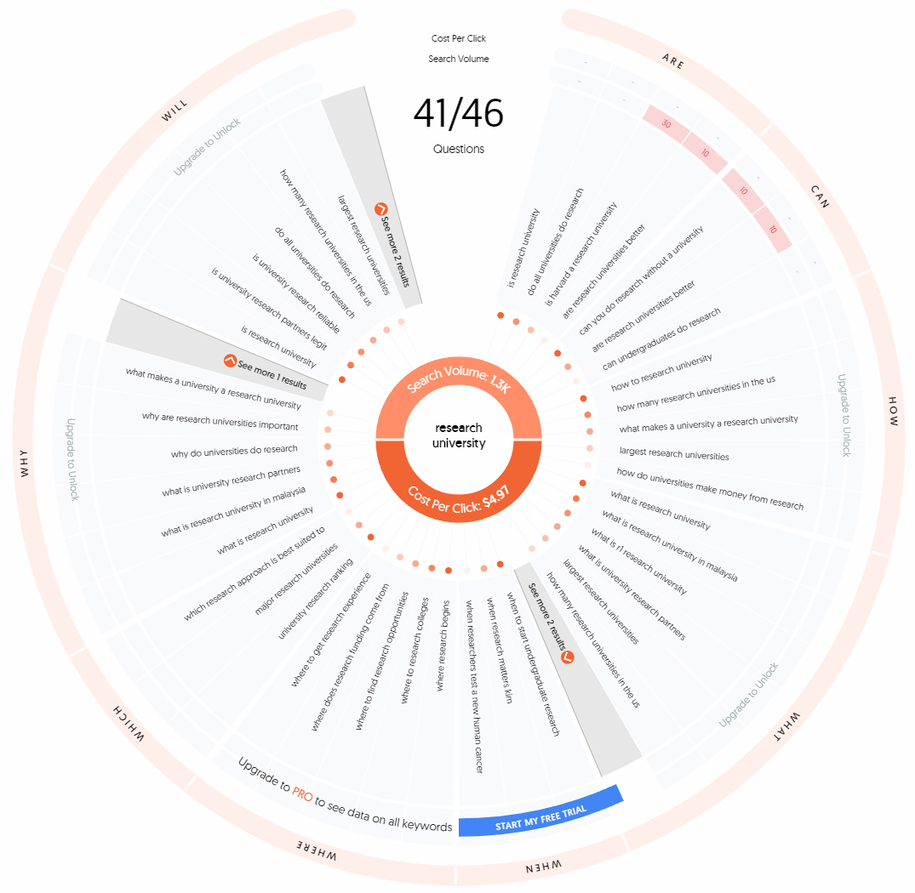
Proactive
answerthepublic.com

Slide 31
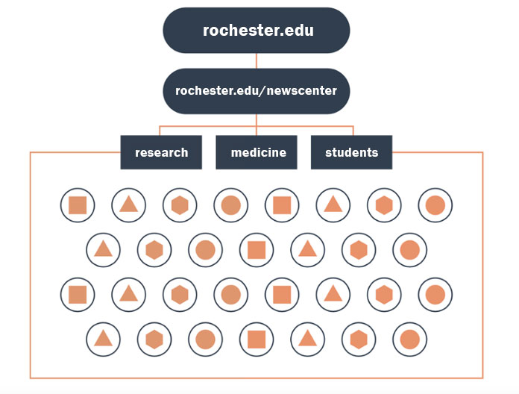
Typical IA

Slide 32
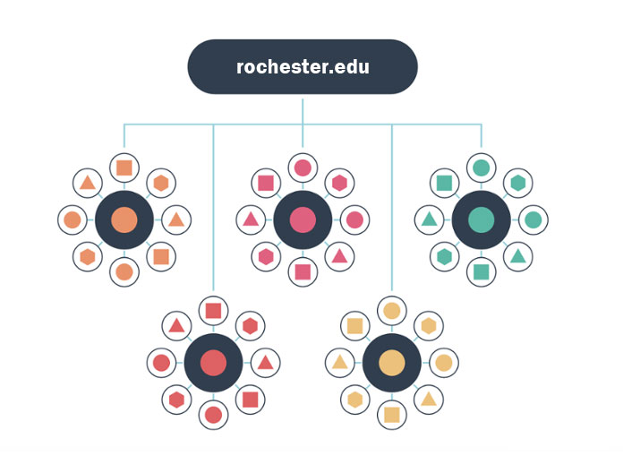
Pillar pages

Slide 33
Pillar pages

Slide 34
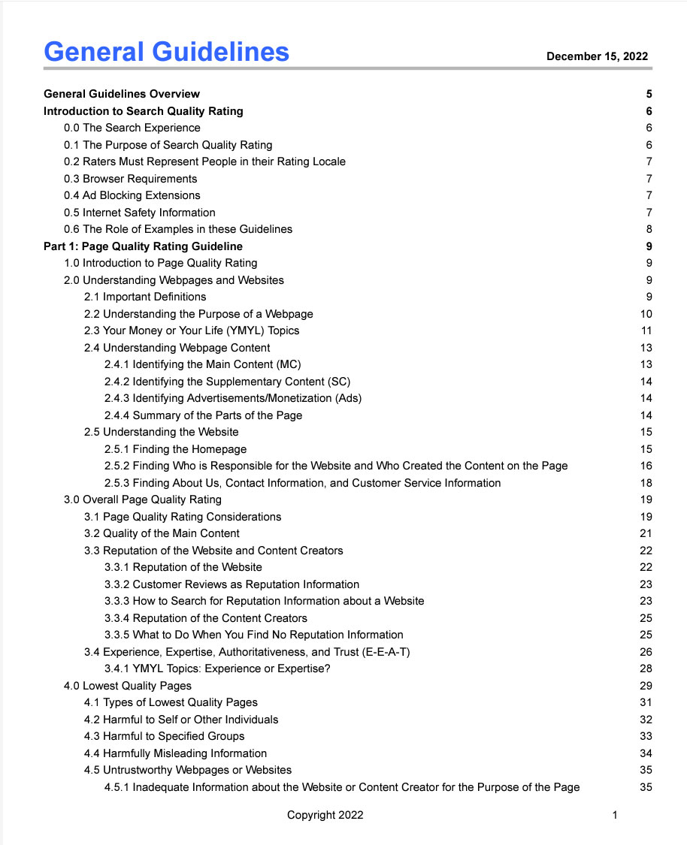
Search Quality
Evaluator Guidelines

Slide 35
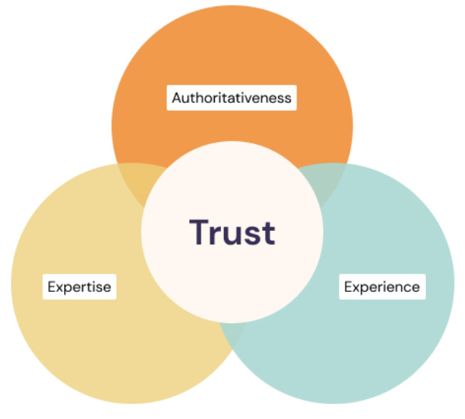
EEAT

Slide 36
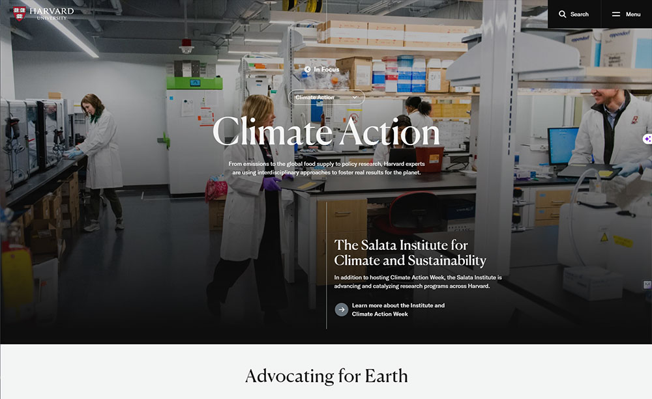
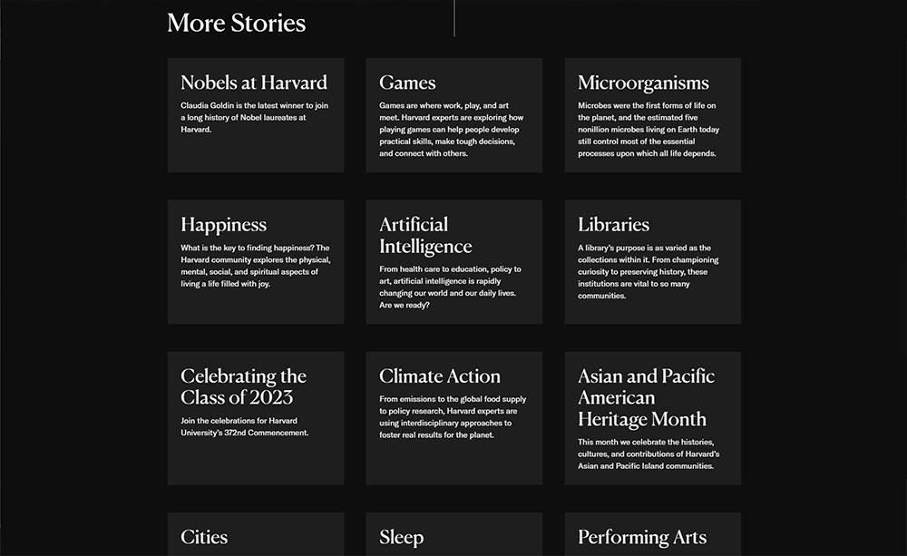

Slide 37
Action items
Is it strategic?
Is there one audience?
Does it matter or help?
Is there an opportunity for content marketing?

Slide 38
Questions?
Brian Piper
bpiper2@ur.rochester.edu
https://brianwpiper.com/
Speaking, workshops, consulting
Content marketing, content optimization
AI, Web3, data/analytics
GetMySlides.info

