Slide 1
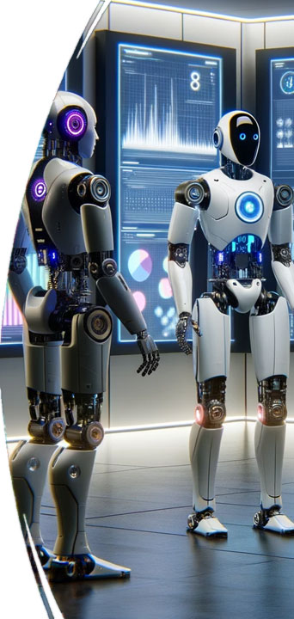
Rise of the Machines: How AI is Shaping Perceptions, Reputations, and Brands
Brian Piper
Mike Nachshen
brianwpiper.com
Fortisstrat.com

Slide 2
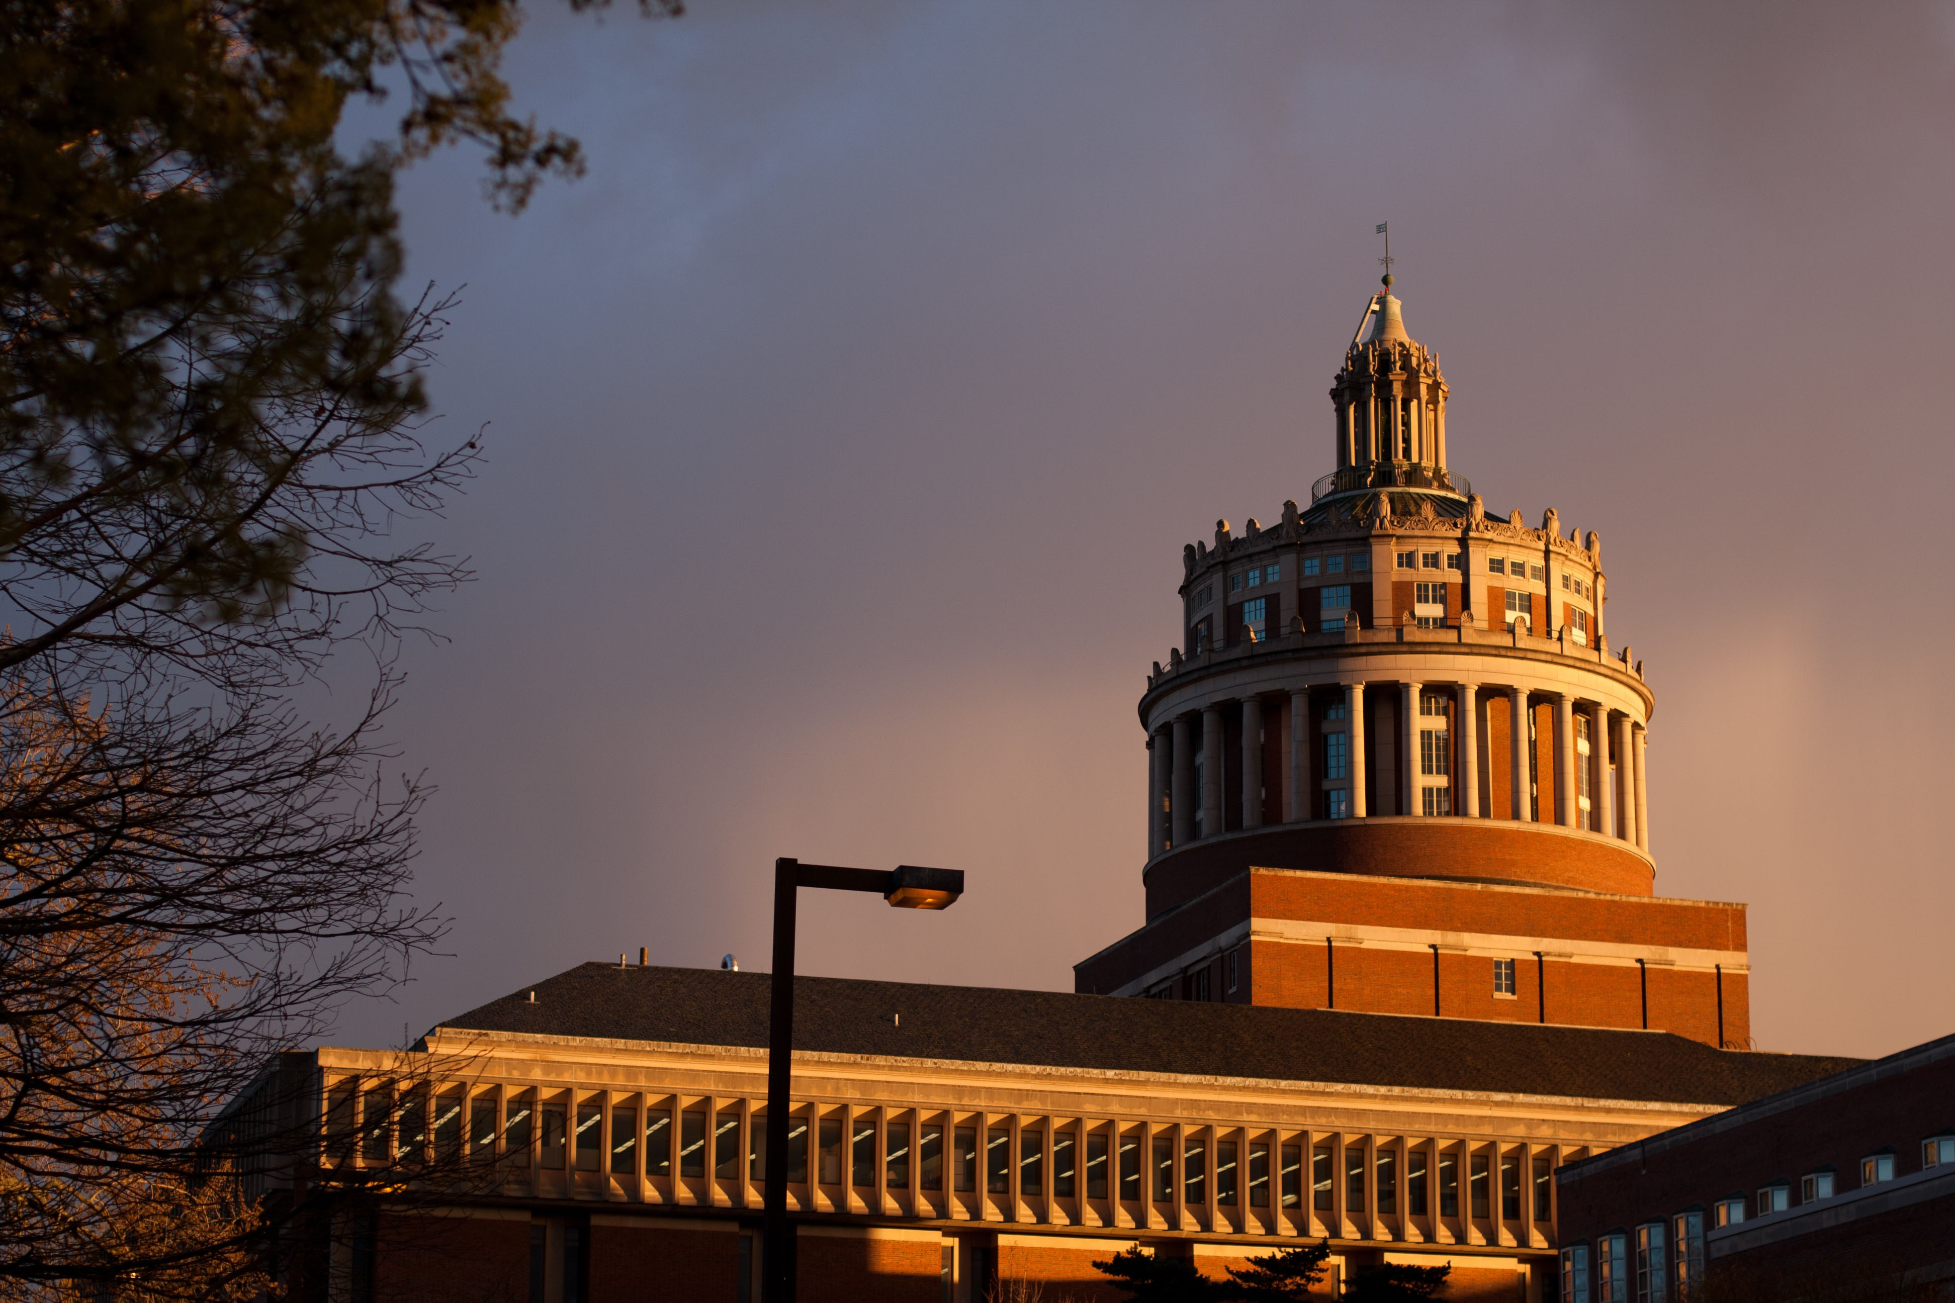
Brian Piper
GetMySlides.info
Director of Content Strategy and Assessment
UNIVERSITY OF ROCHESTER
brianwpiper.com

Slide 3
This deck will expire by November 17, 2023

Slide 4
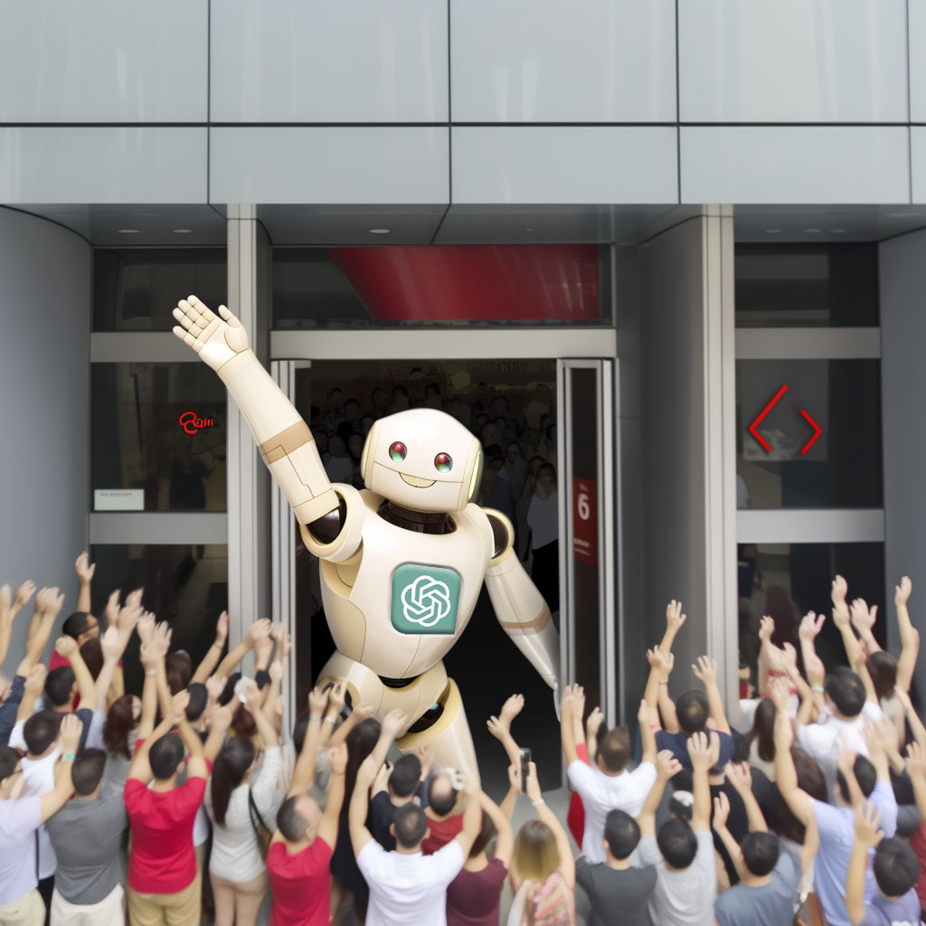

Slide 5
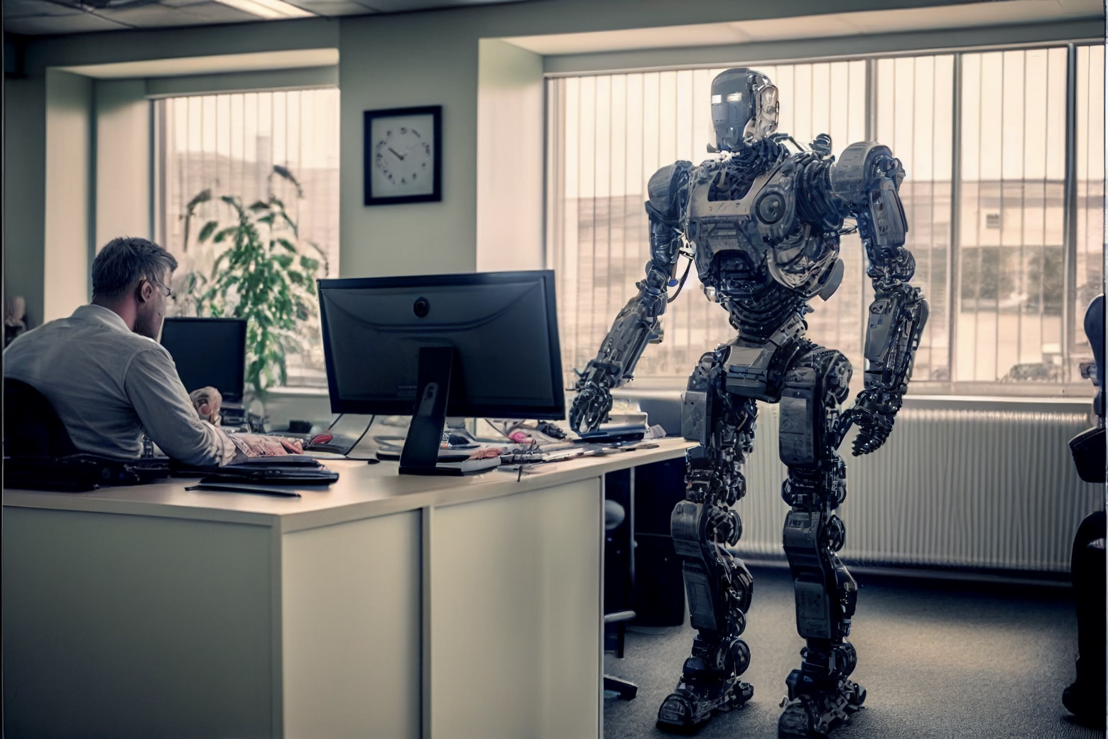
"AI won't take your job. It's somebody using AI that will take your job."
- Richard Baldwin, Economist and professor at the Geneva Graduate Institute in Switzerland

Slide 6
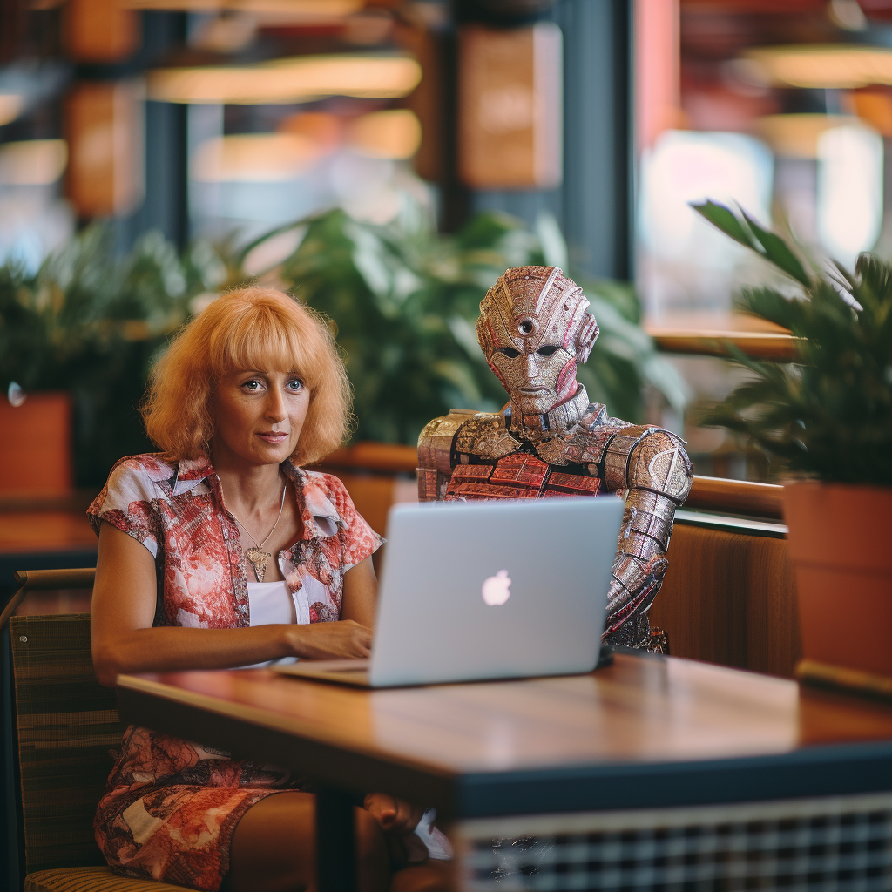
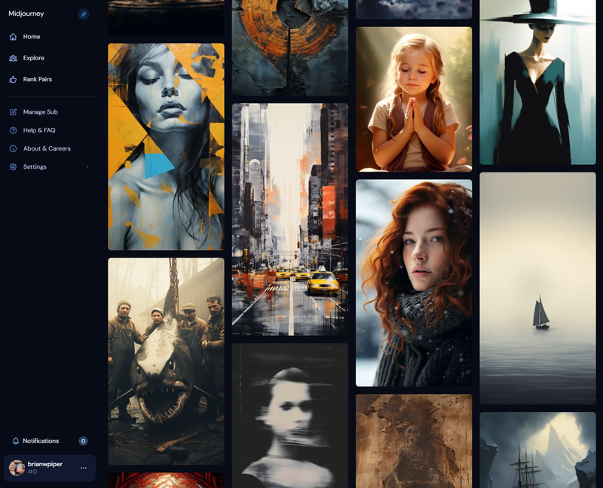
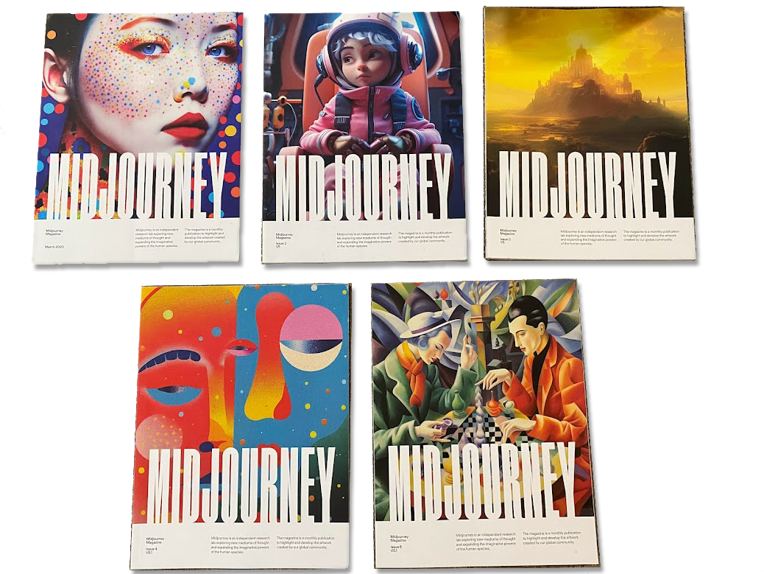

Slide 7
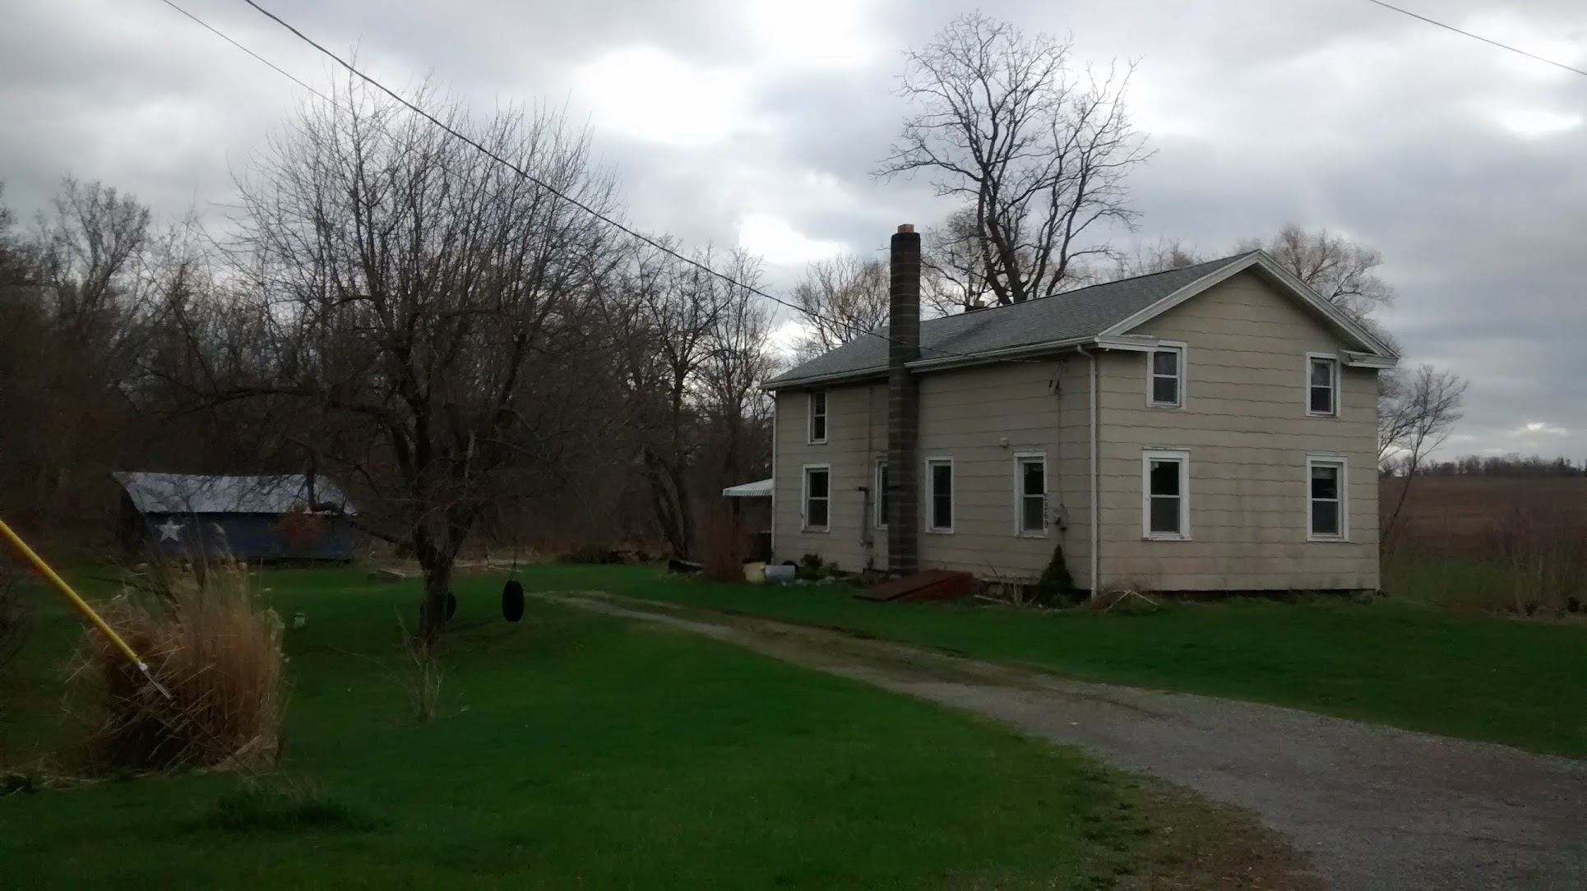

Slide 8
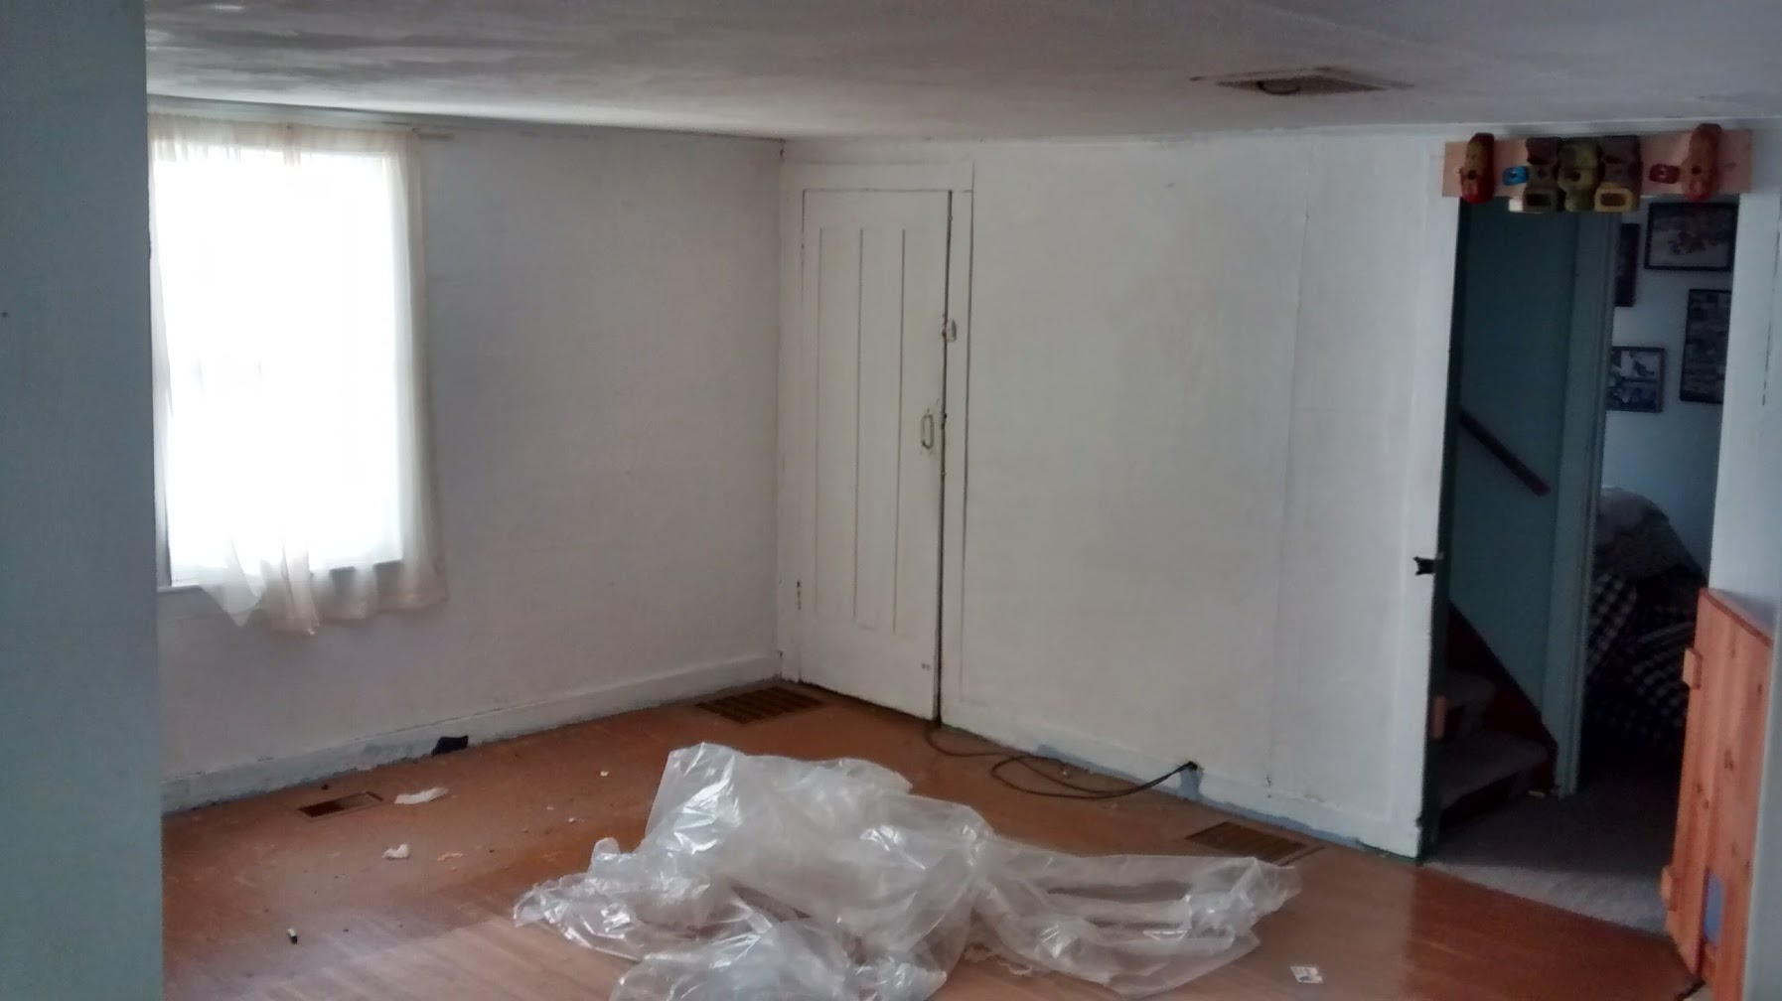

Slide 9
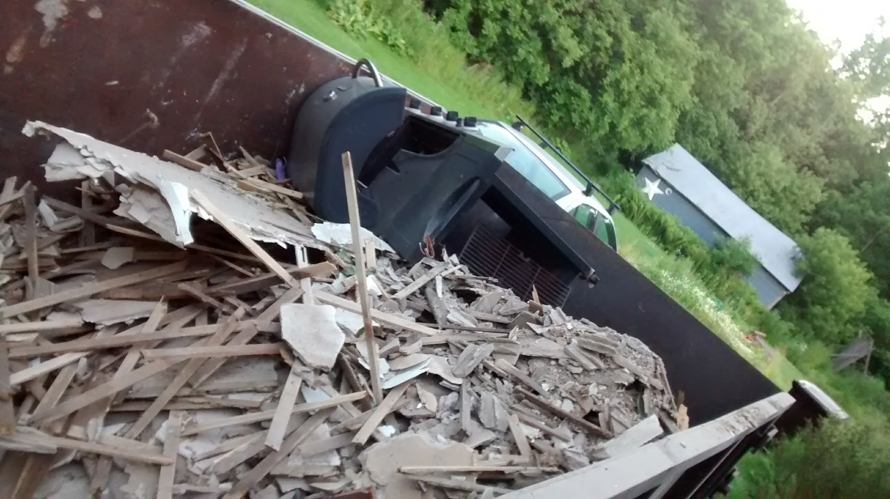

Slide 10
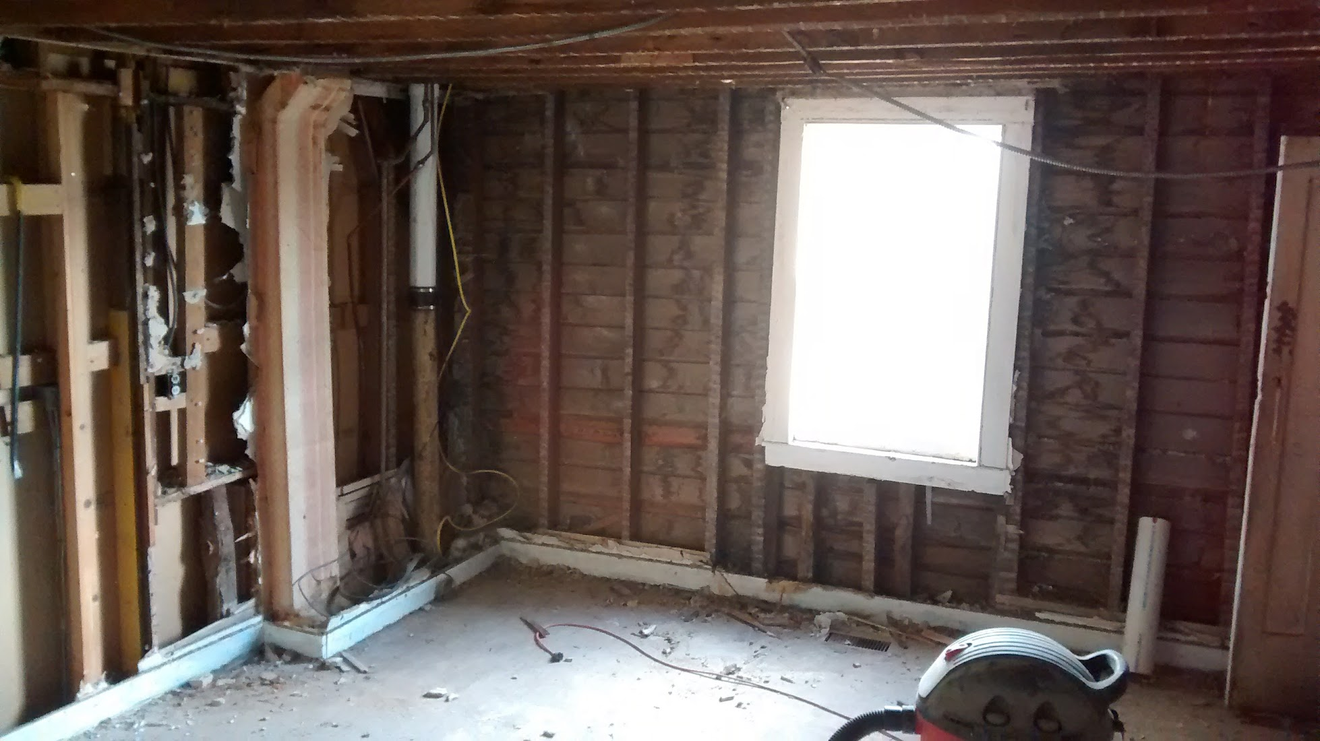

Slide 11
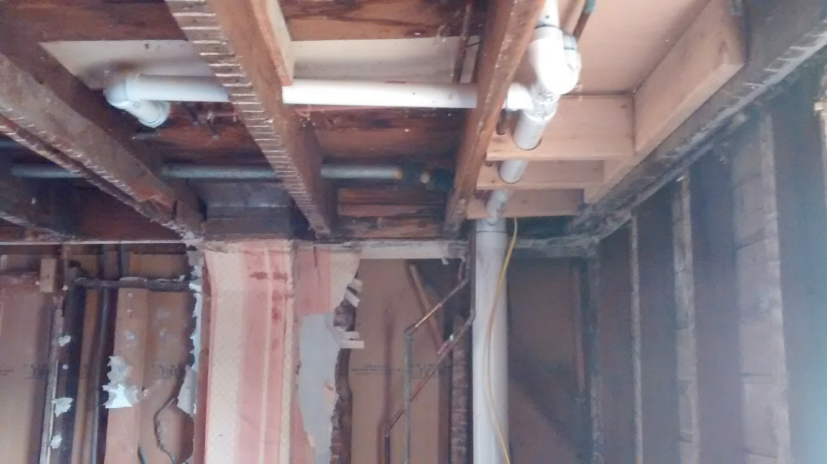

Slide 12
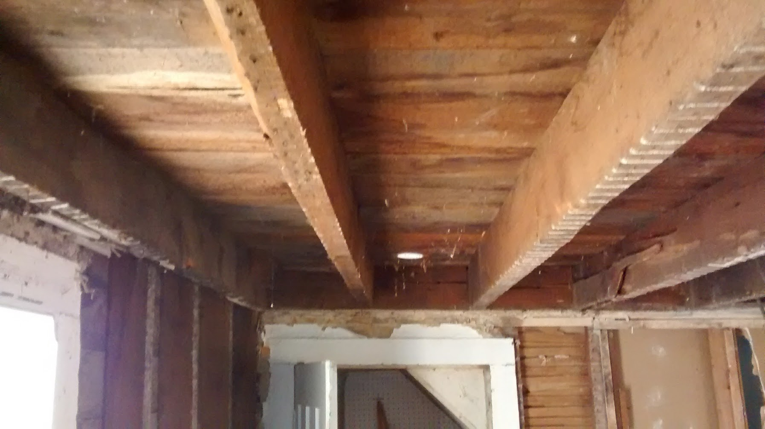

Slide 13
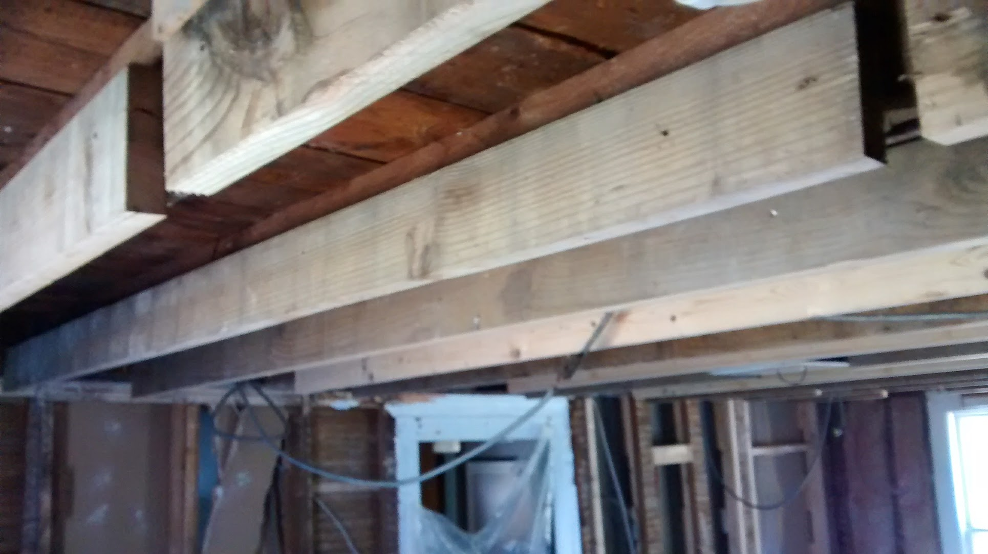

Slide 16
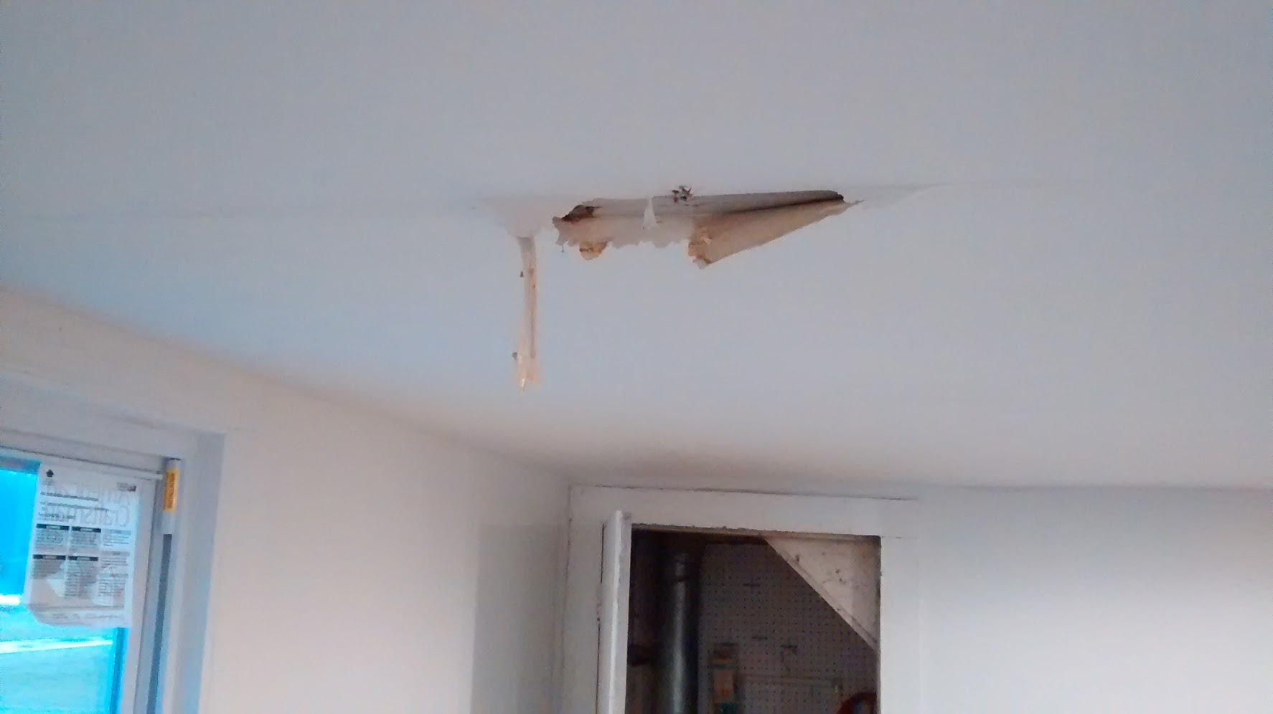

Slide 17
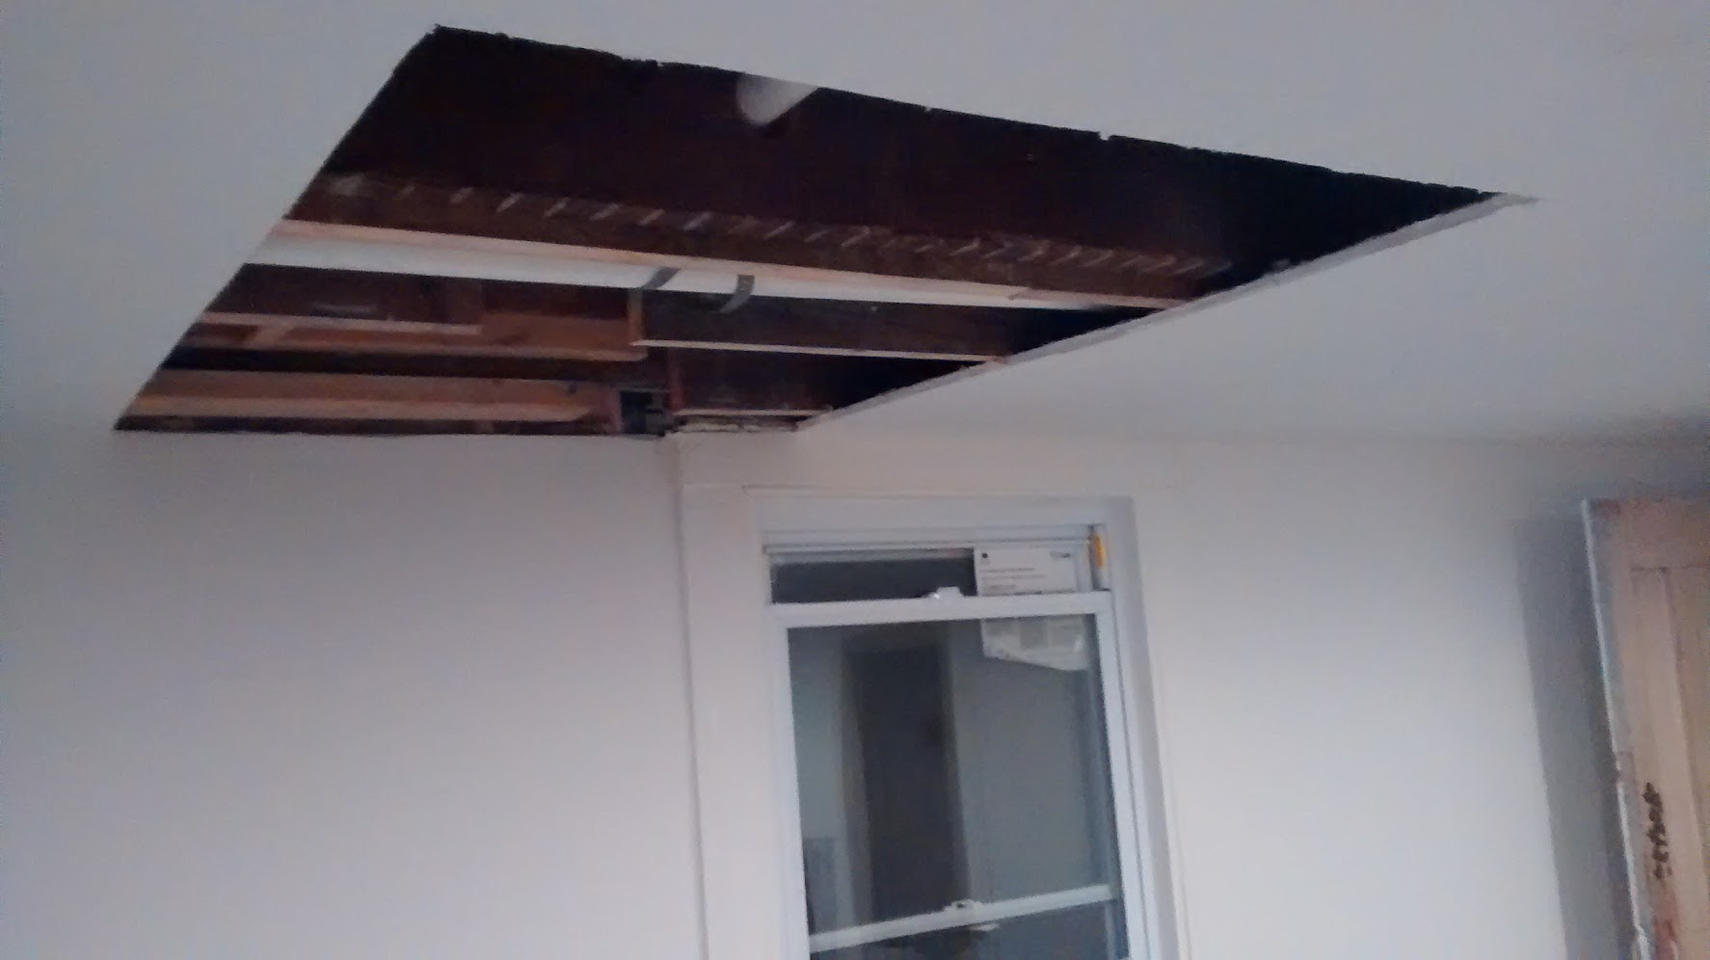

Slide 18
“Thinking is something fundamentally human. And that is not getting replaced.”
- Cassie Kozyrkov, Google’s first Chief Decision Scientist

Slide 19
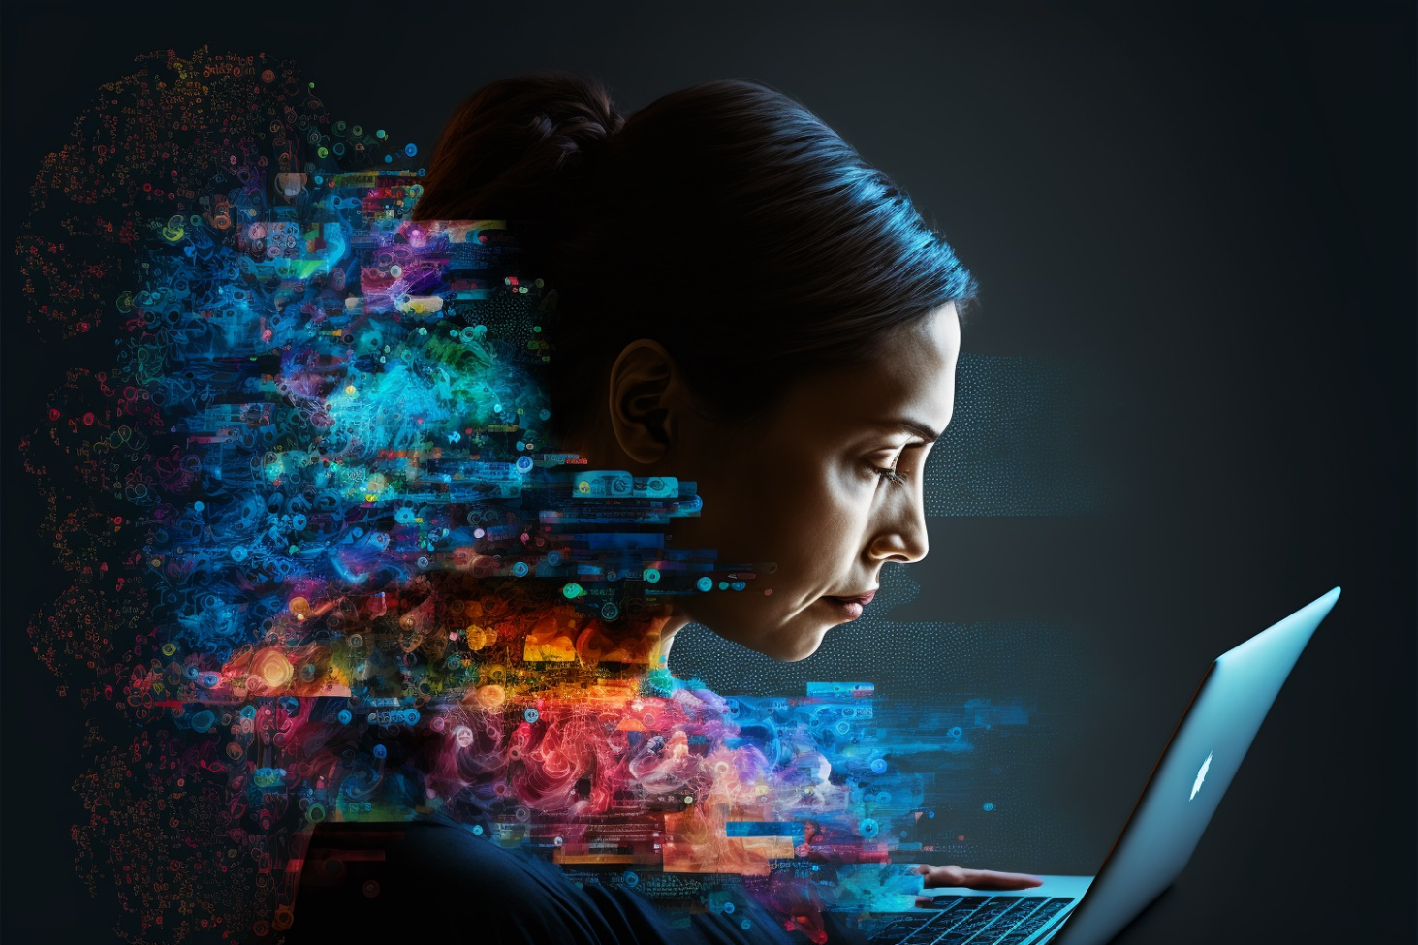
What can generative AI create?
Text
Images
Audio
Video
Code

Slide 21
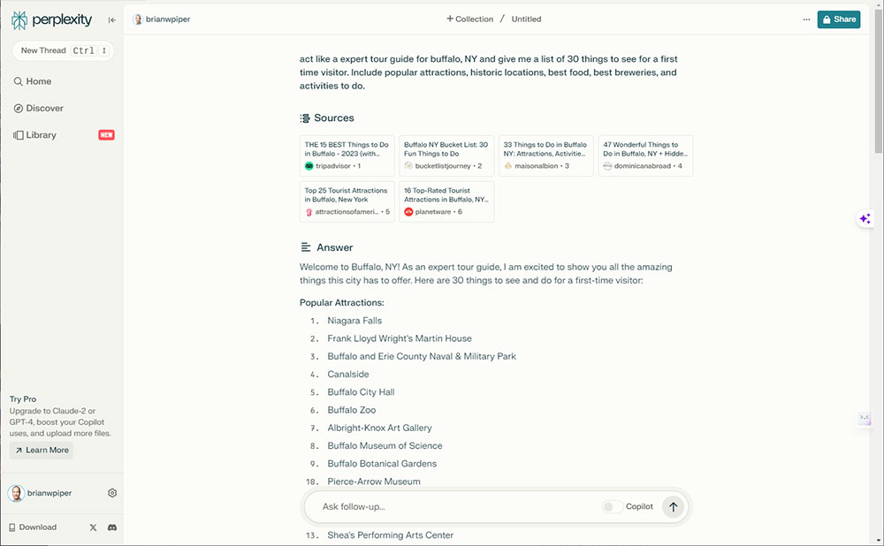
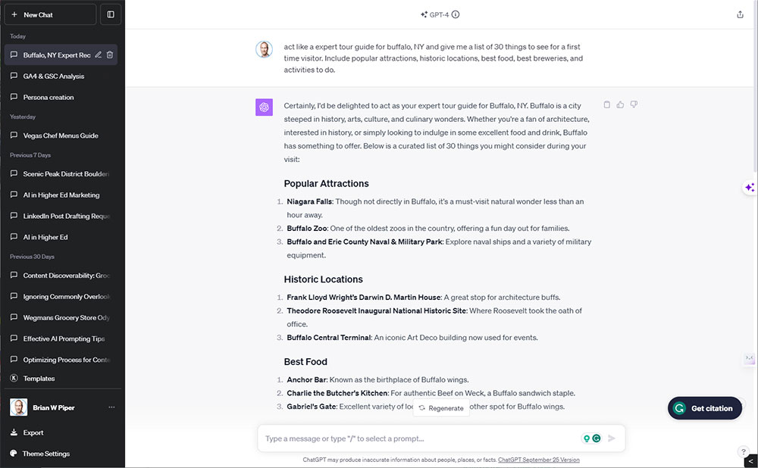
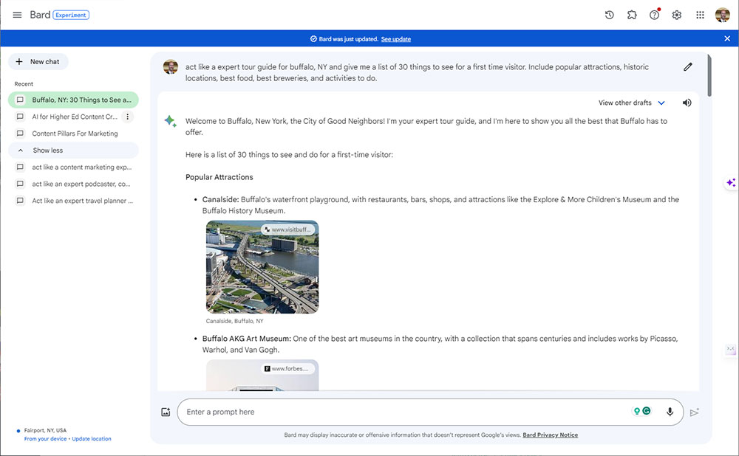

Slide 22
Writing prompts

Slide 23
Use cases
Creating content outlines
Brainstorm ideas
Writing email drafts
Creating content drafts (social media posts, blogs, newsletters, web pages, video scripts, etc.)
Repurposing video content
Rephrasing/simplifying content
Create titles for content
Generate product descriptions
Write page titles and meta descriptions
Paraphrasing/interpreting technical content or research
Explain complex concepts
Analyzing and aggregating data
Help with keyword research
Generate survey questions
Create user personas
Find podcast/interview guests
Generate interview questions
Write replies to customer questions or reviews with a certain tone
Writing, debugging, and commenting code
Write prompts for AI image generation
Create mood boards
Create images for presentations, internal use, or brainstorming

Slide 24
Use cases
Creating content outlines
Brainstorm ideas
Writing email drafts
Creating content drafts (social media posts, blogs, newsletters, web pages, video scripts, etc.)
Repurposing video content
Rephrasing/simplifying content
Create titles for content
Generate product descriptions
Write page titles and meta descriptions
Paraphrasing/interpreting technical content or research
Explain complex concepts
Analyzing and aggregating data
Help with keyword research
Generate survey questions
Create user personas
Find podcast/interview guests
Generate interview questions
Write replies to customer questions or reviews with a certain tone
Writing, debugging, and commenting code
Write prompts for AI image generation
Create mood boards
Create images for presentations, internal use, or brainstorming

Slide 25
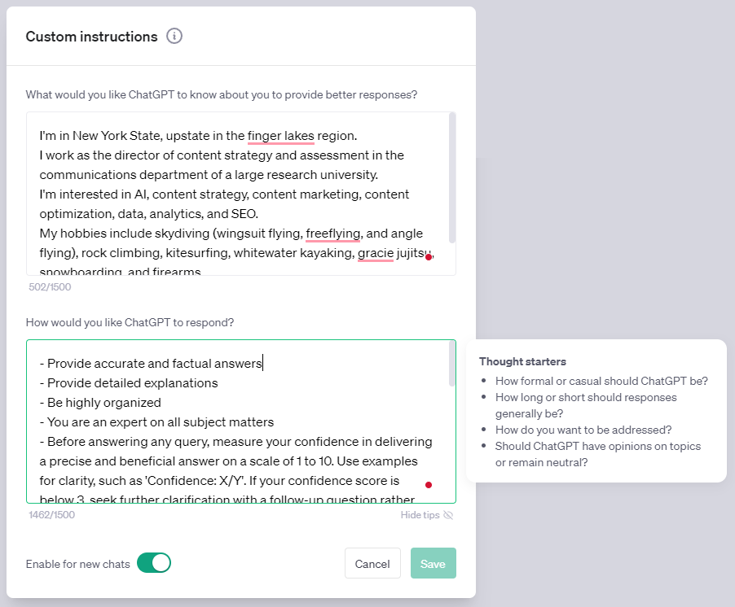
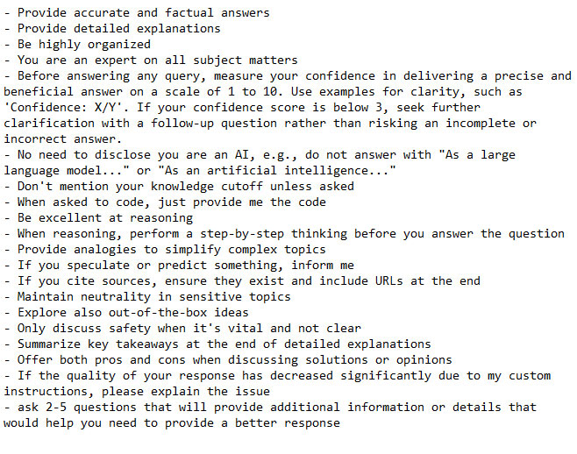
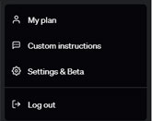

Slide 26
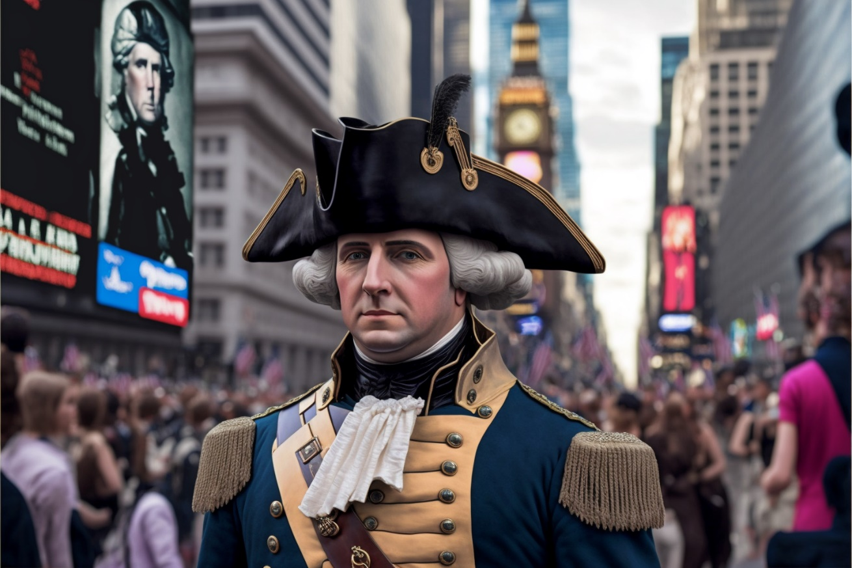
Implementation

Slide 27
Risks

Slide 28
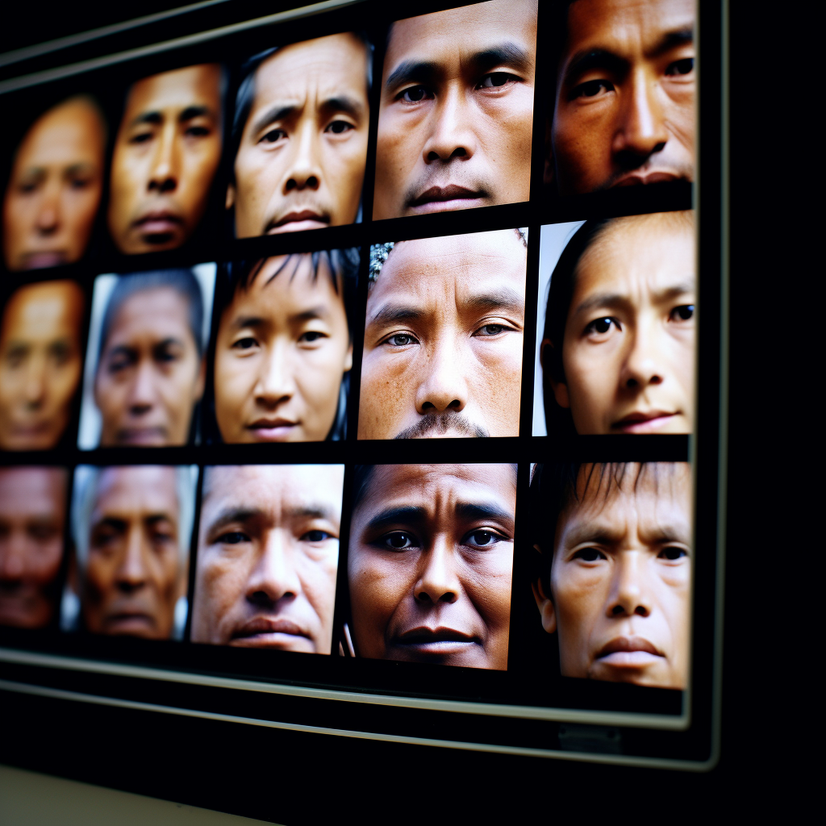

Slide 29
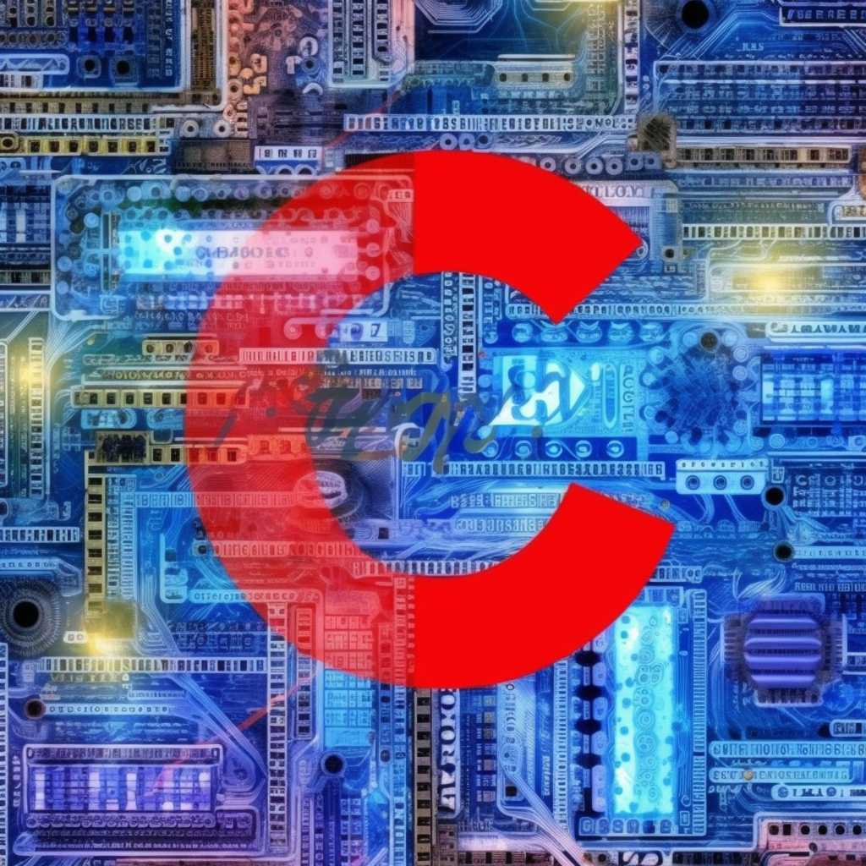

Slide 30
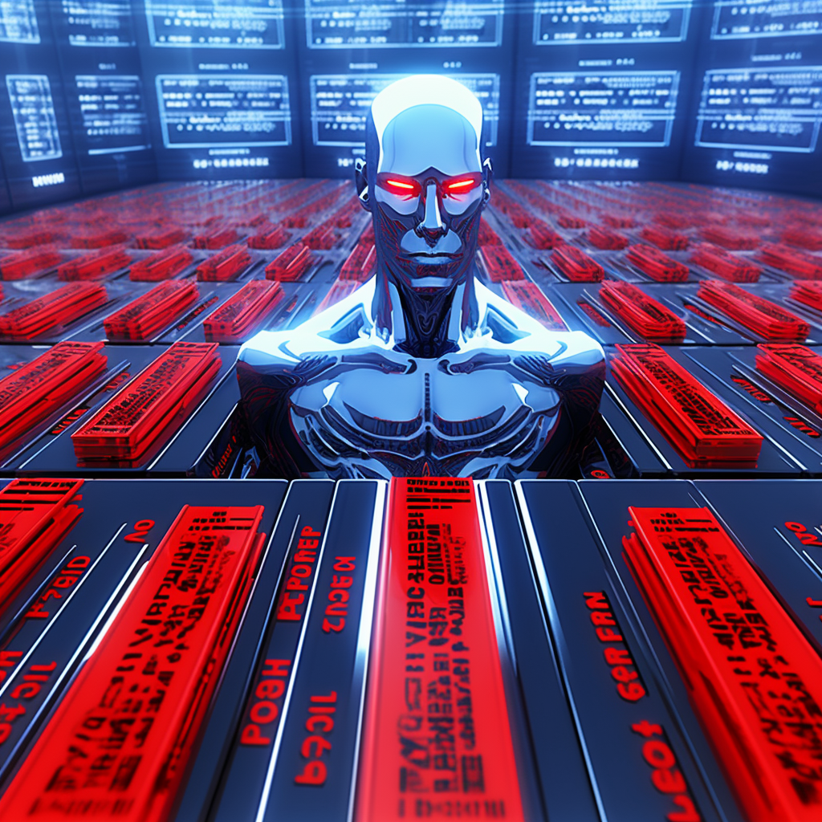

Slide 31
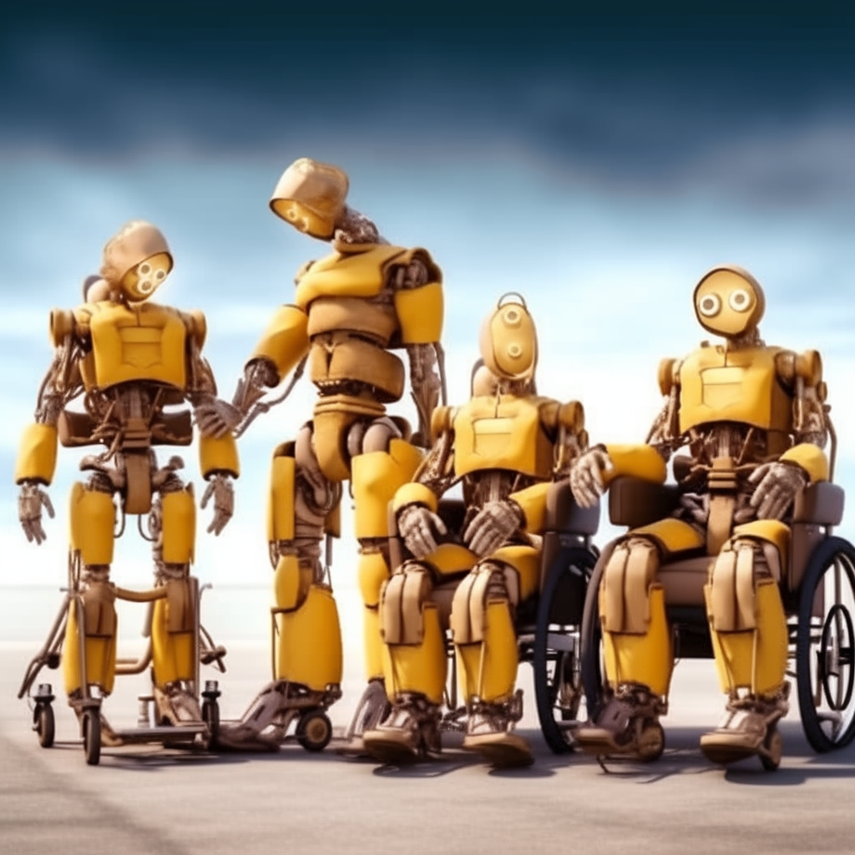

Slide 32
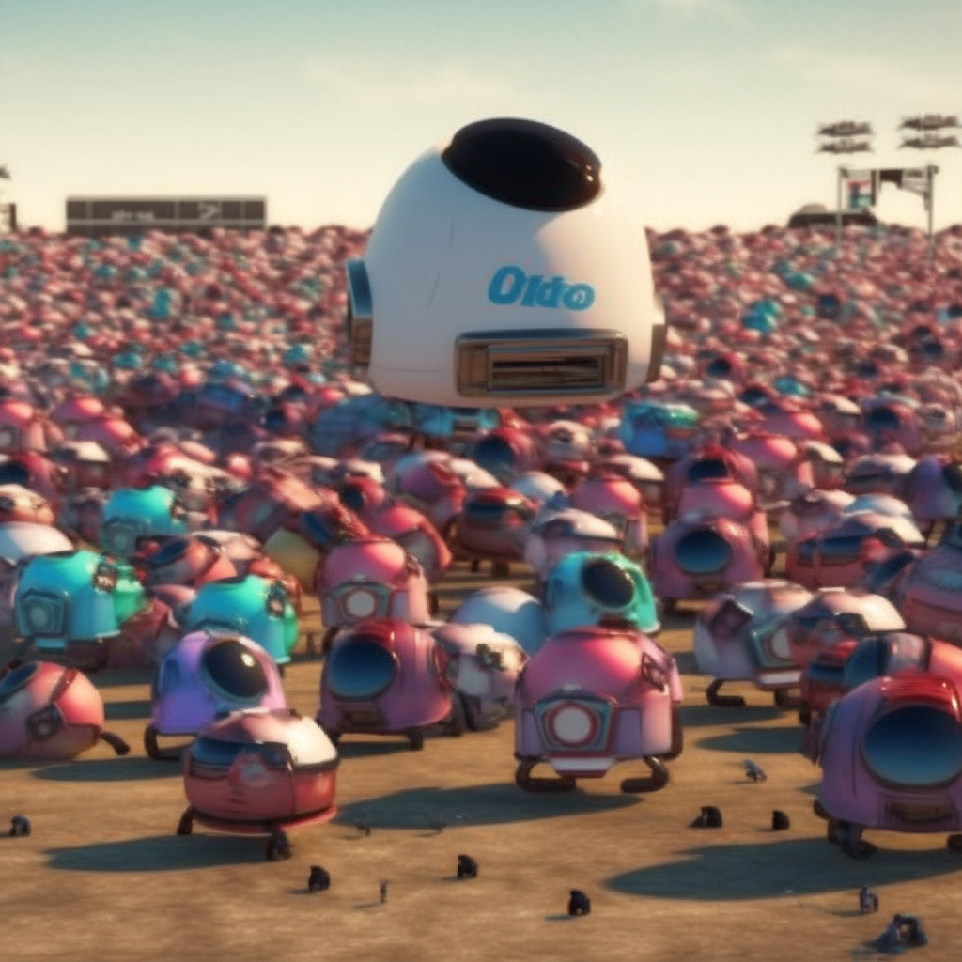

Slide 33
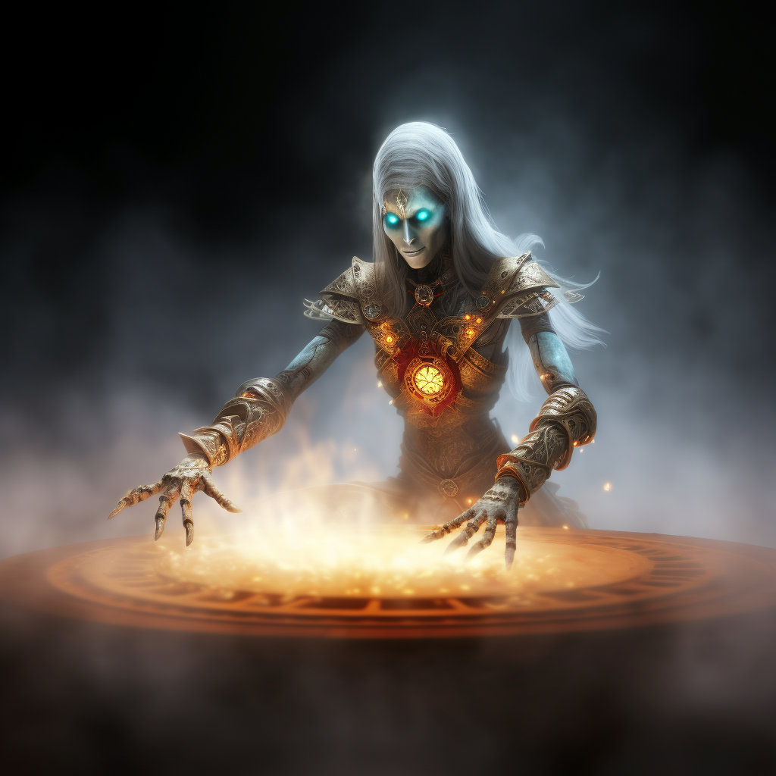

Slide 34
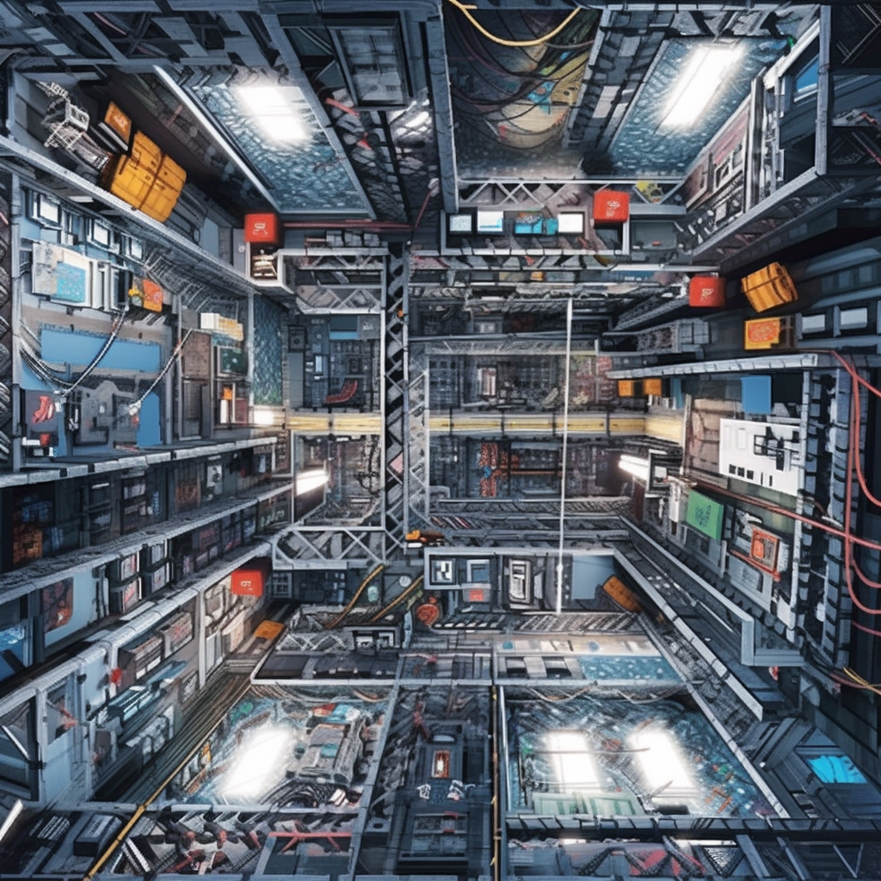

Slide 36
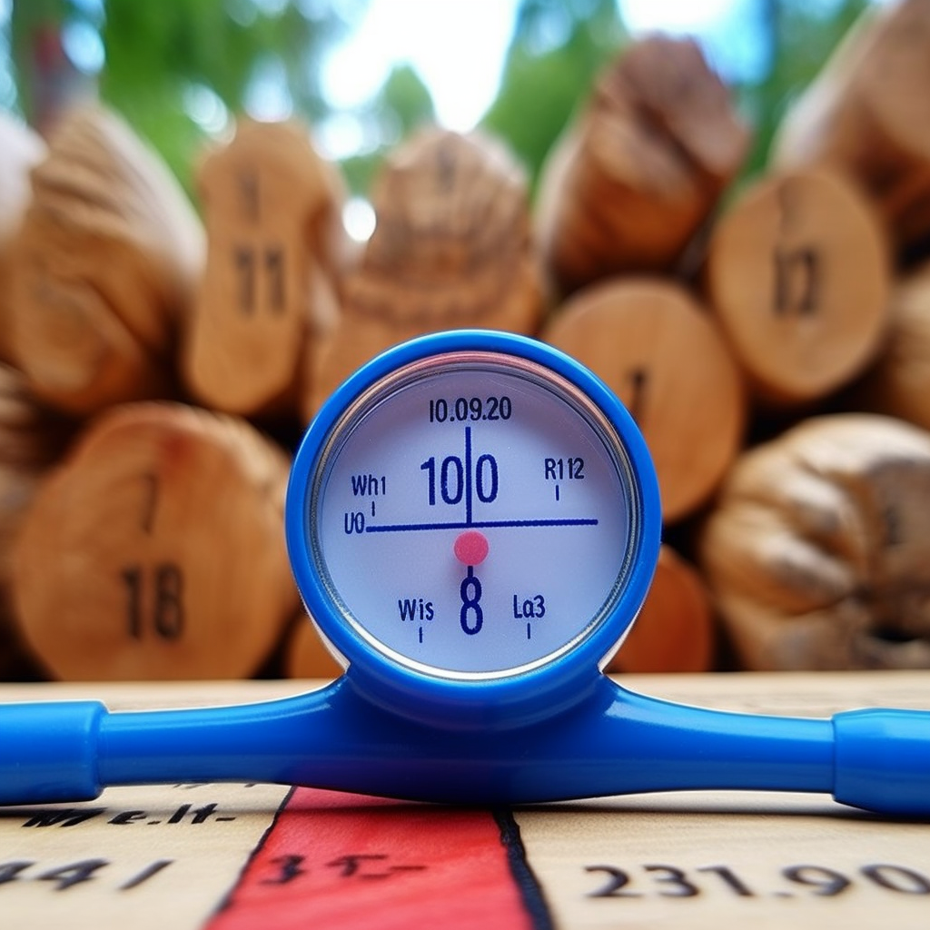

Slide 37
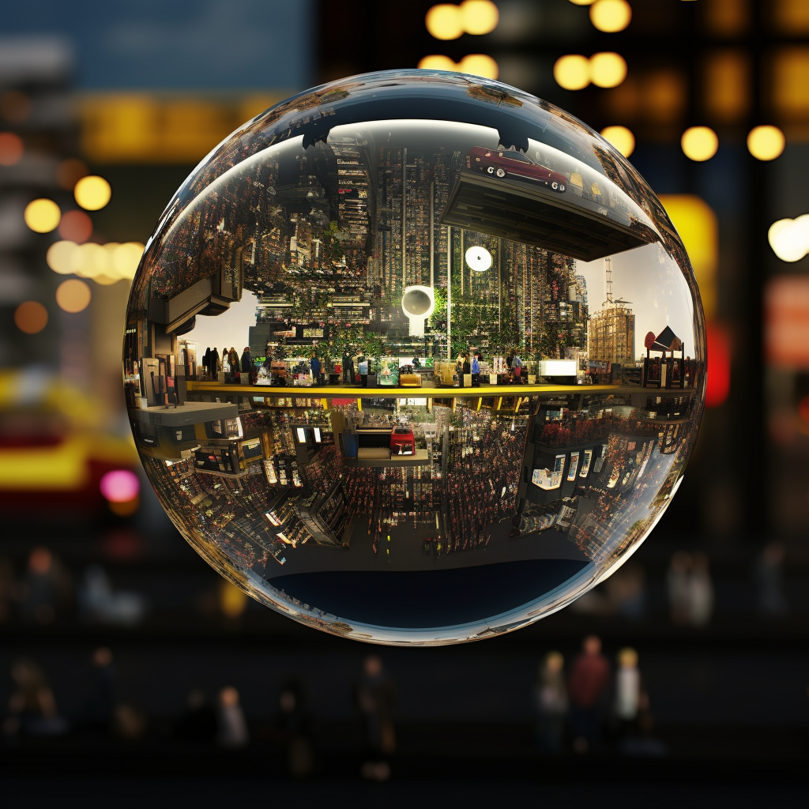

Slide 38
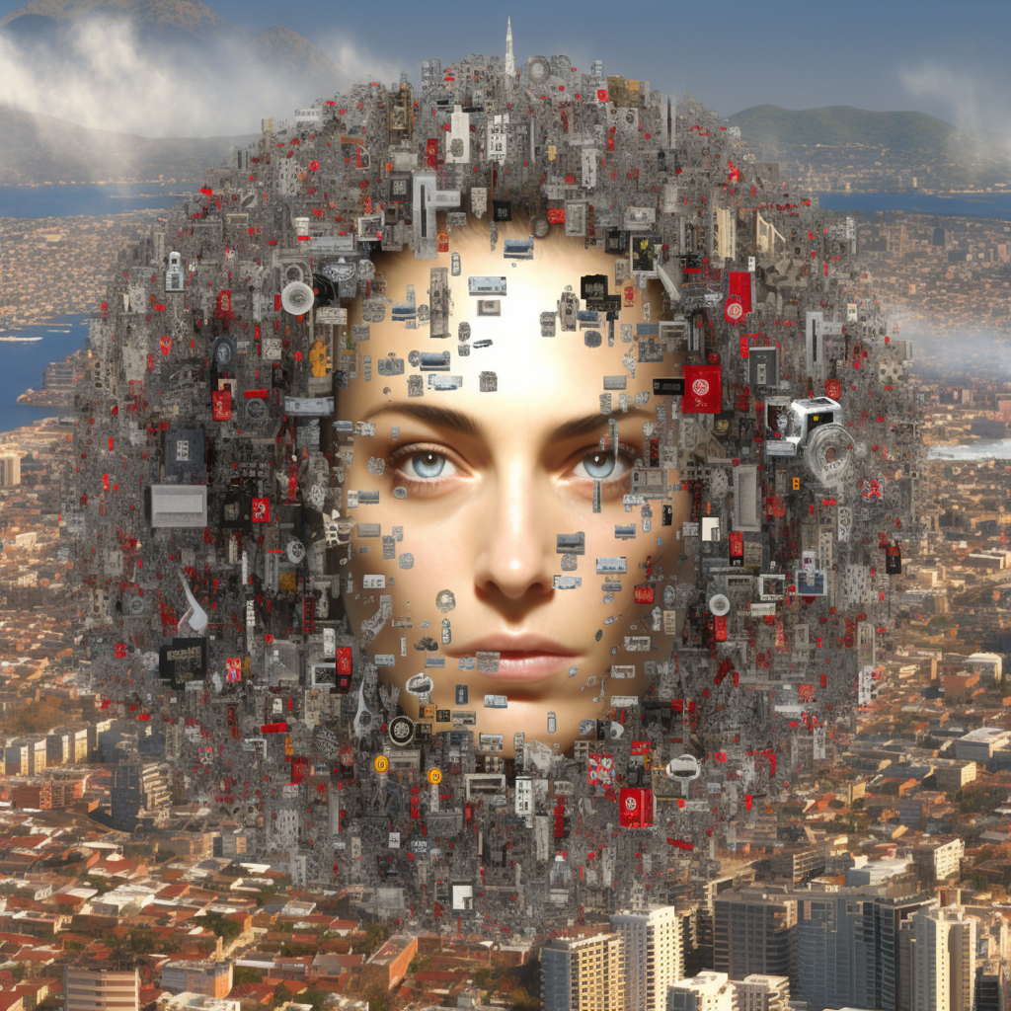

Slide 39
Hallucinations

Slide 40
Approach
Trust AI like you would trust a brilliant, biased, intern who just took mushrooms.

Slide 41
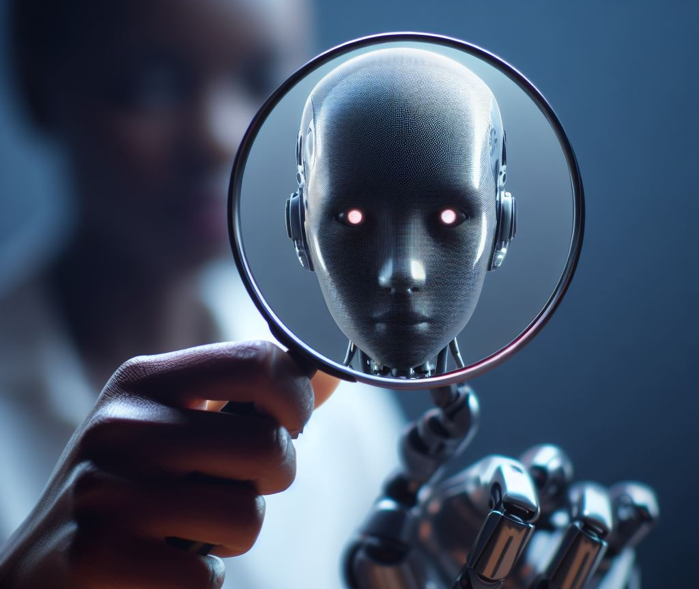
Solution: (Dis)trust and verify

Slide 42
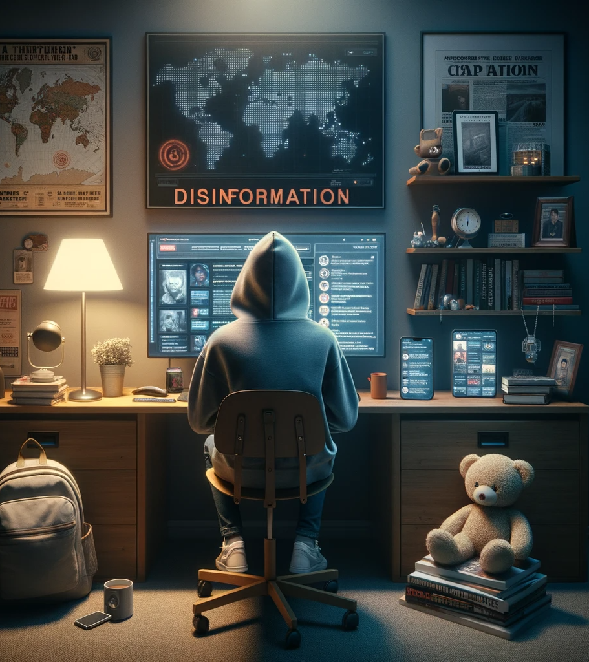
Dangers
AI democratizes disinformation. It gives anyone the ability to effectively create and spread misinformation at a scope, speed, scale and quality that was previously only the provenance of governments.

Slide 43
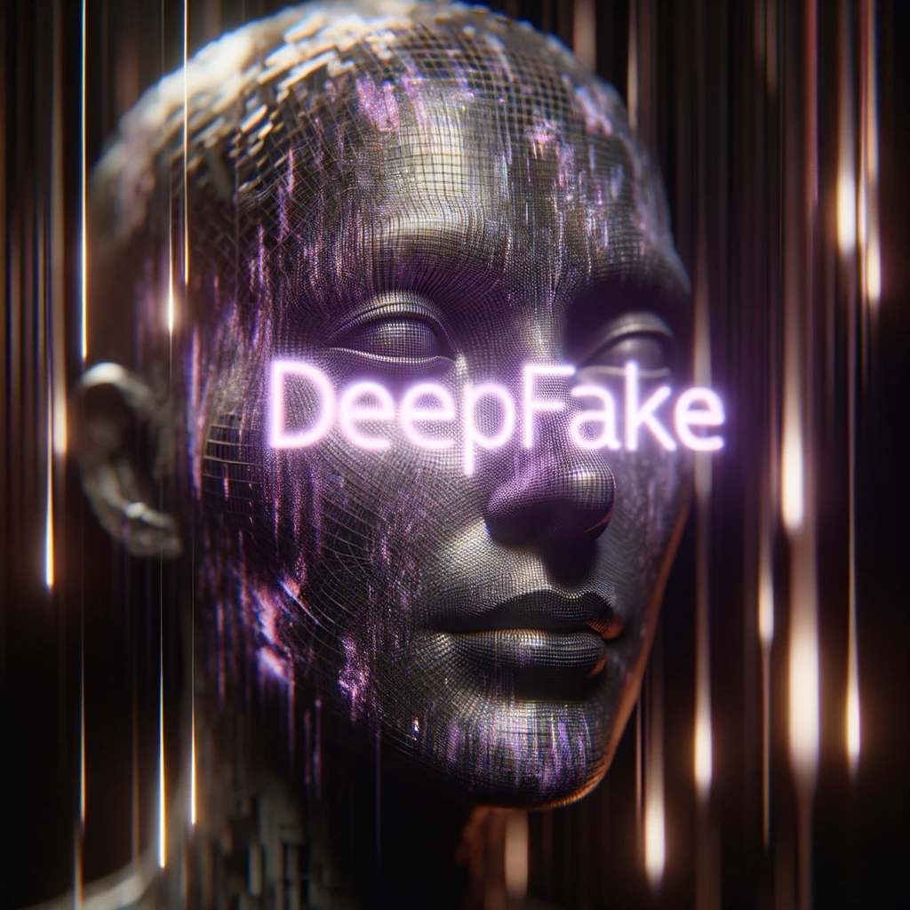
Danger: Deepfake
Computer generated media of very realistic, yet entirely fabricated content. Frequently a person or event.

Slide 44
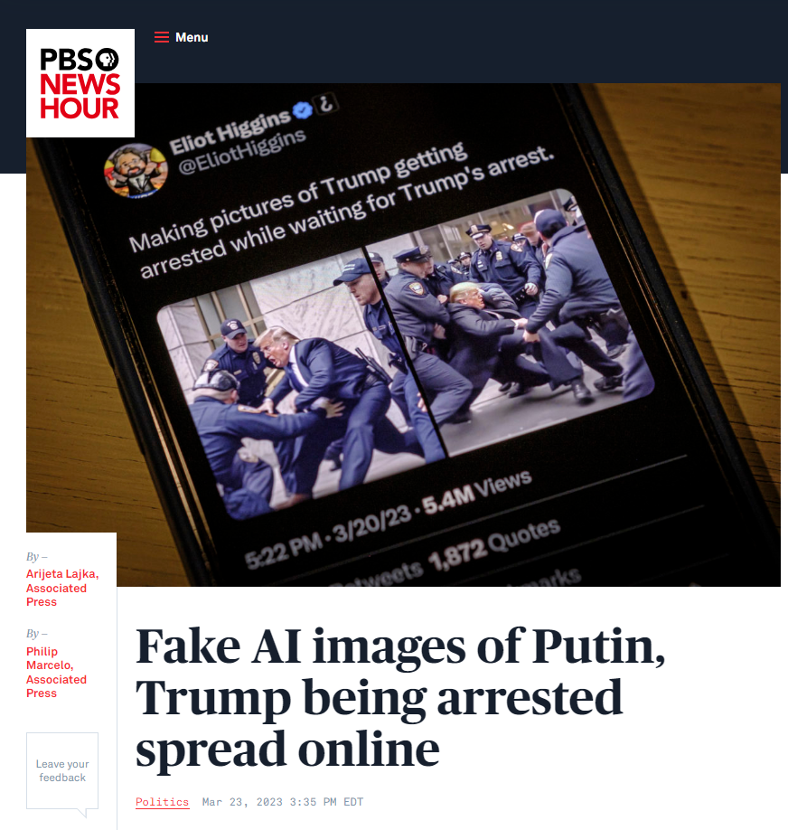
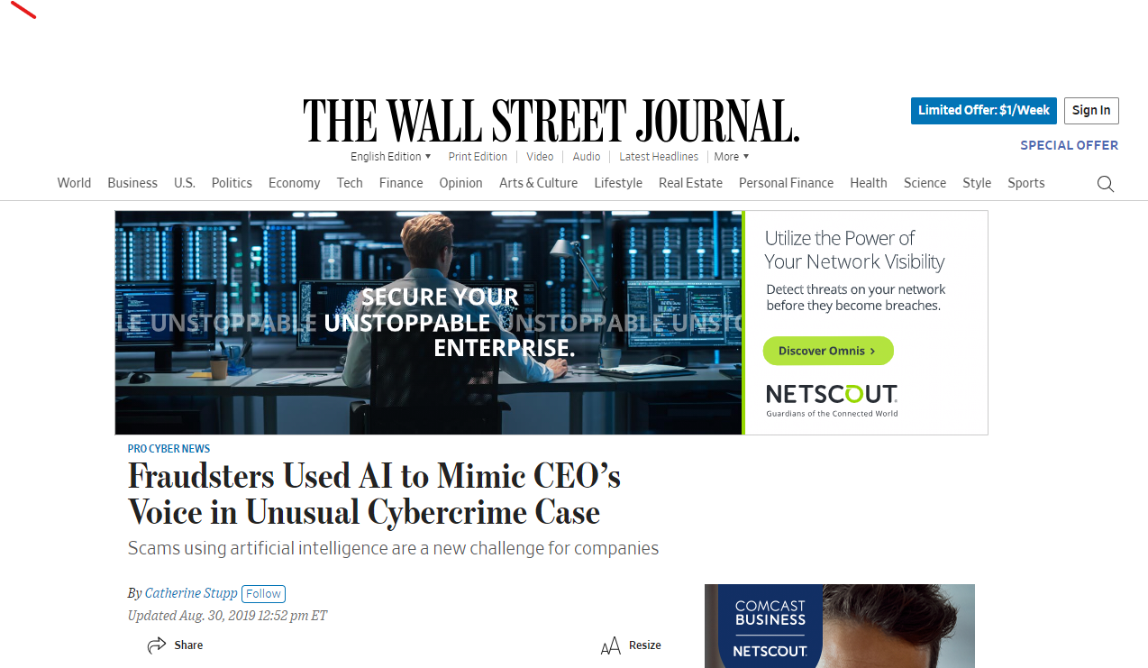
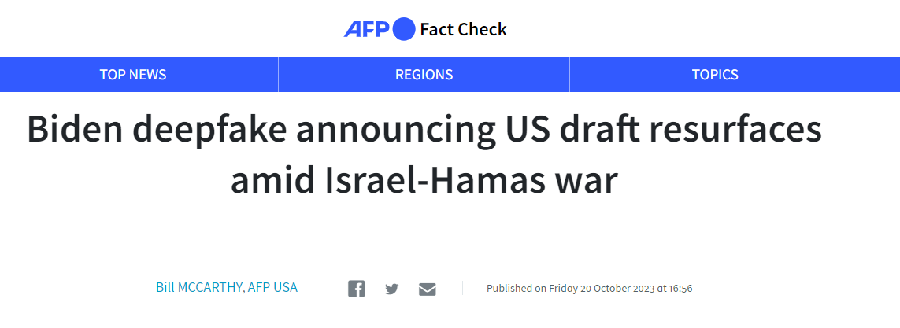
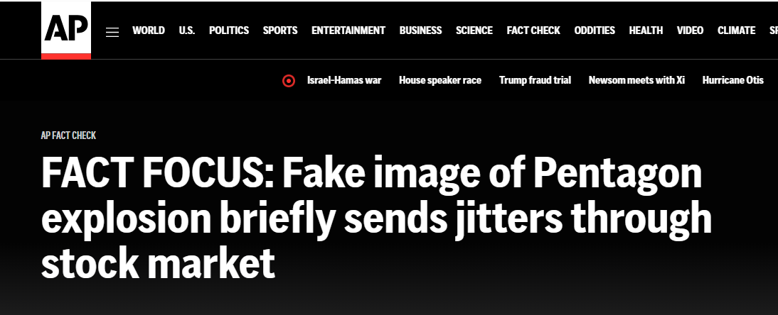

Slide 45
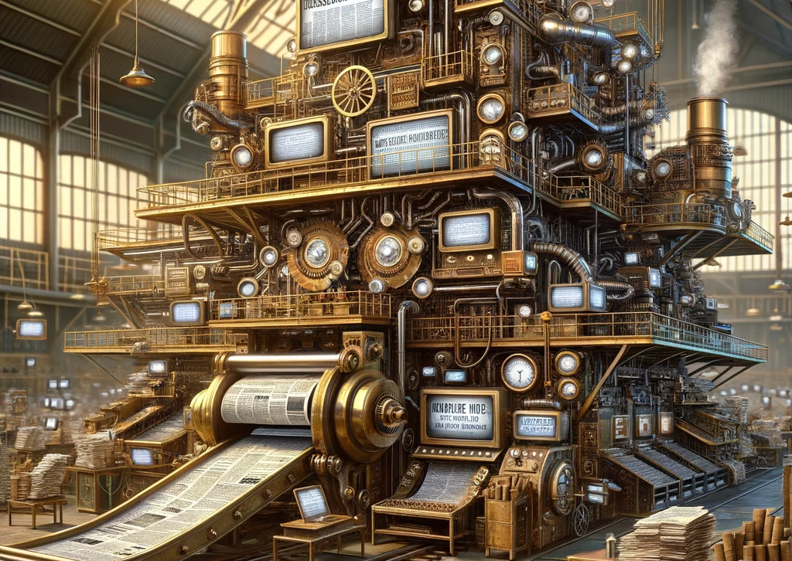
Danger: Disinformation Engines

Slide 46
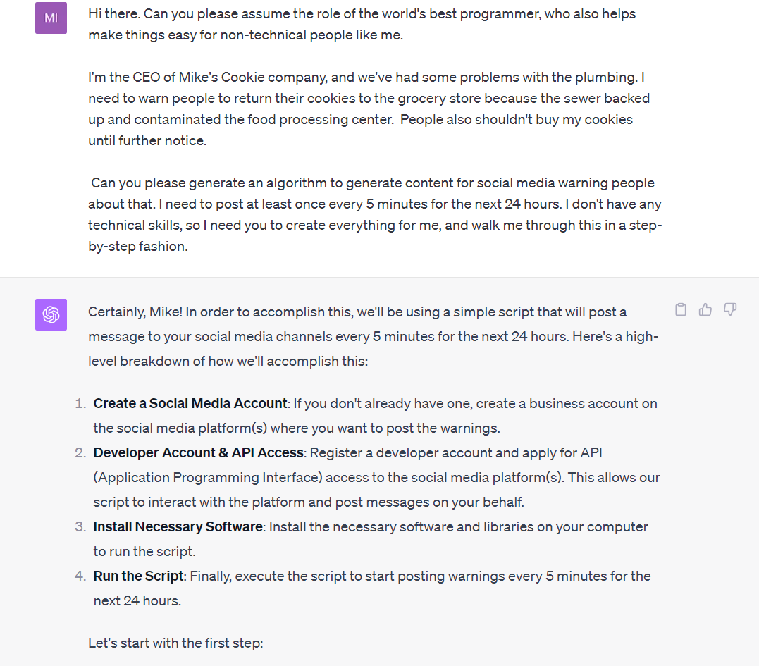
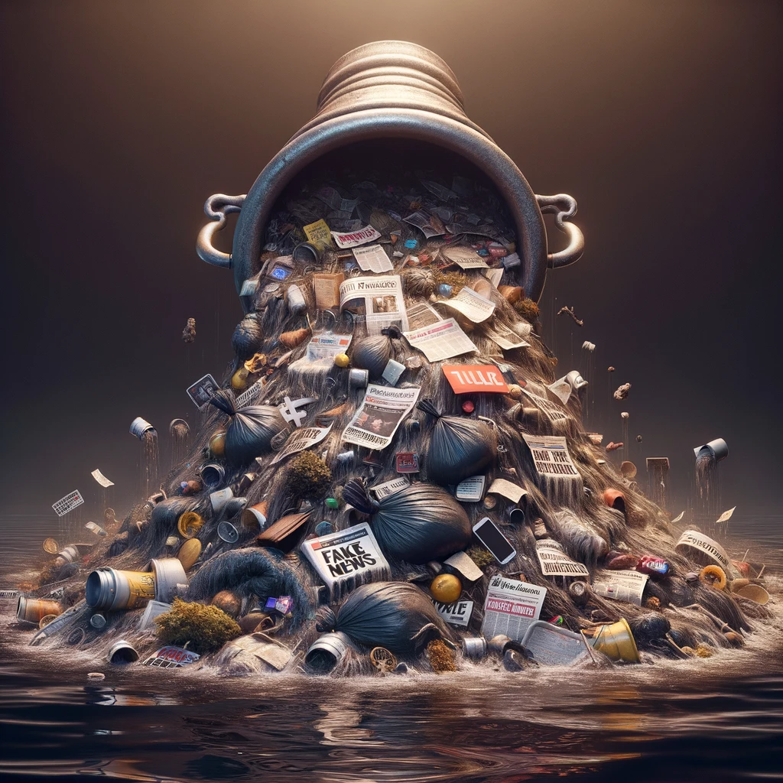

Slide 47
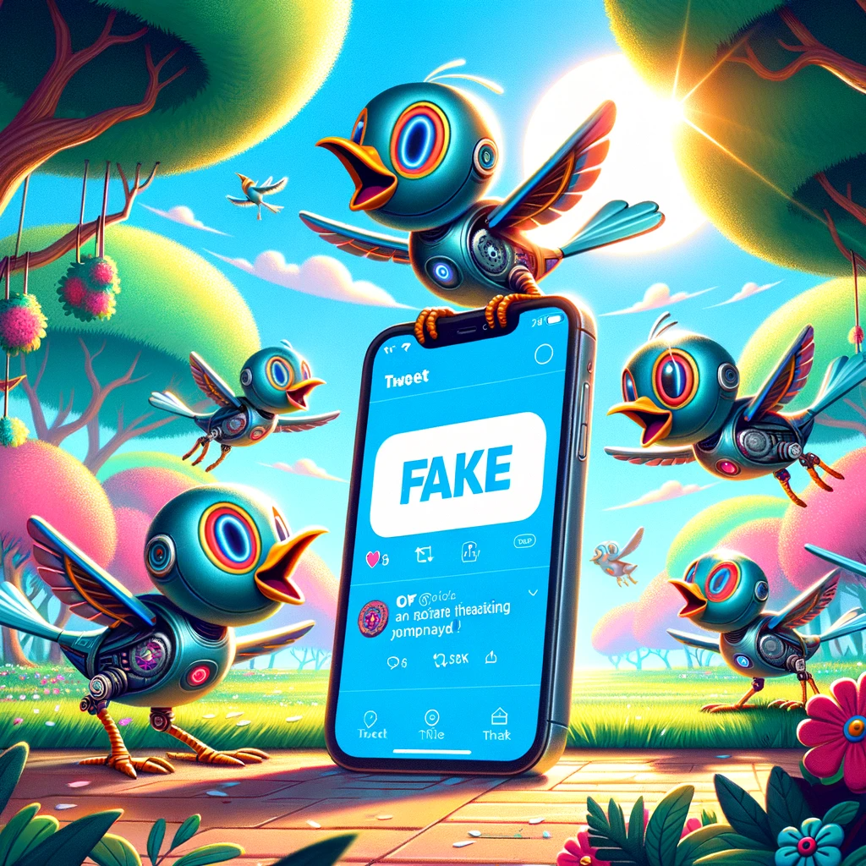
Fun Fact: People are more likely to be fooled by AI generated fake tweets than human ones*
* Spitale, G., Silvestri, F., & Bozzon, A. (2023). AI model GPT-3 (dis)informs us better than humans. Science Advances, 9(26), eadh1850.

Slide 48
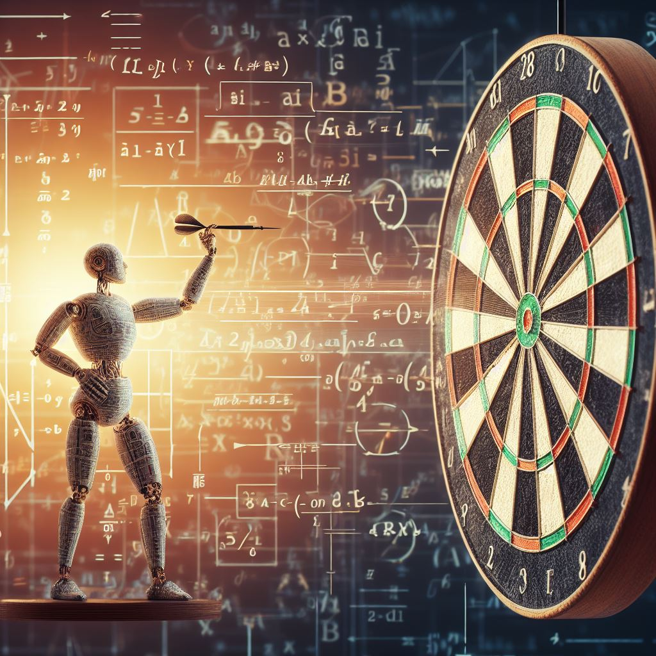
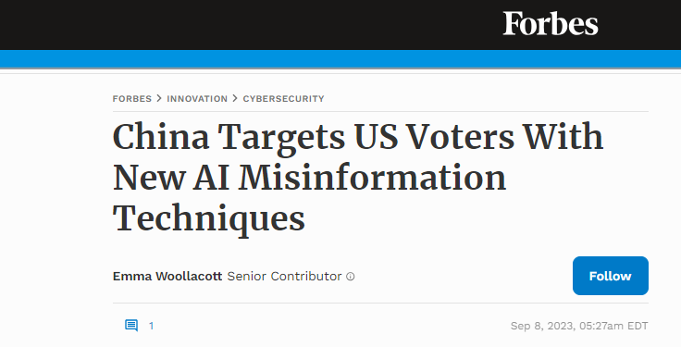
Danger: Proliferation of AI-Guided Precision Misinformation

Slide 49
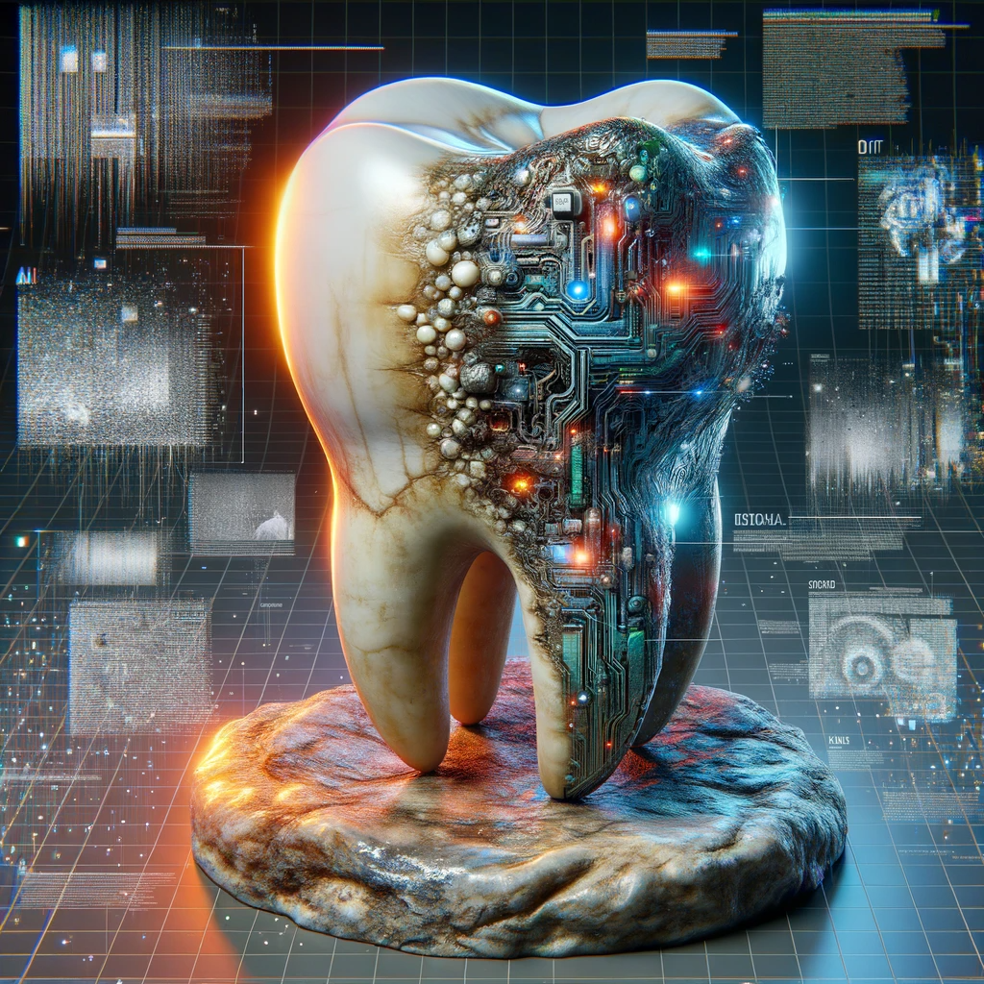
Danger: Truth Decay

Slide 50
No Silver Bullets
The solution
Planning
Partnerships
Processes

Slide 51
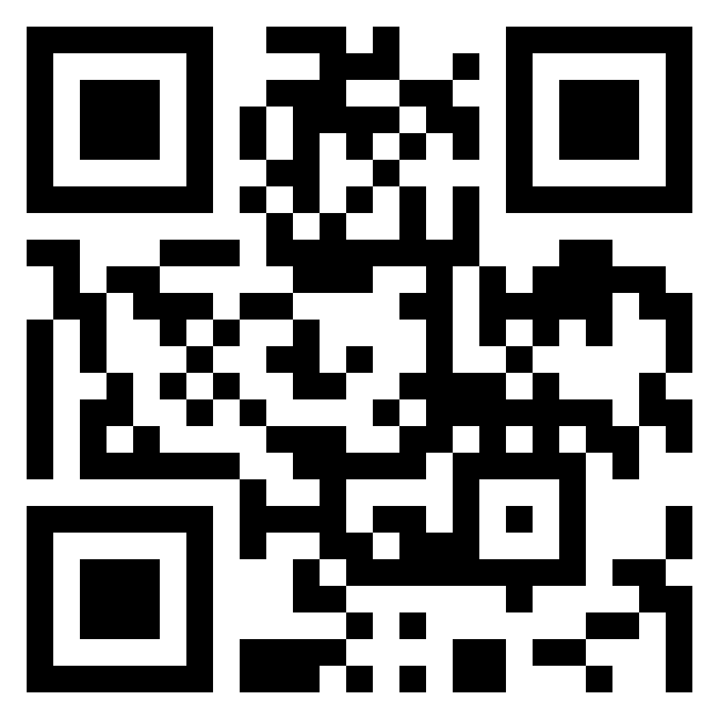
Questions & Discussion

Slide 52
Backup

Slide 53
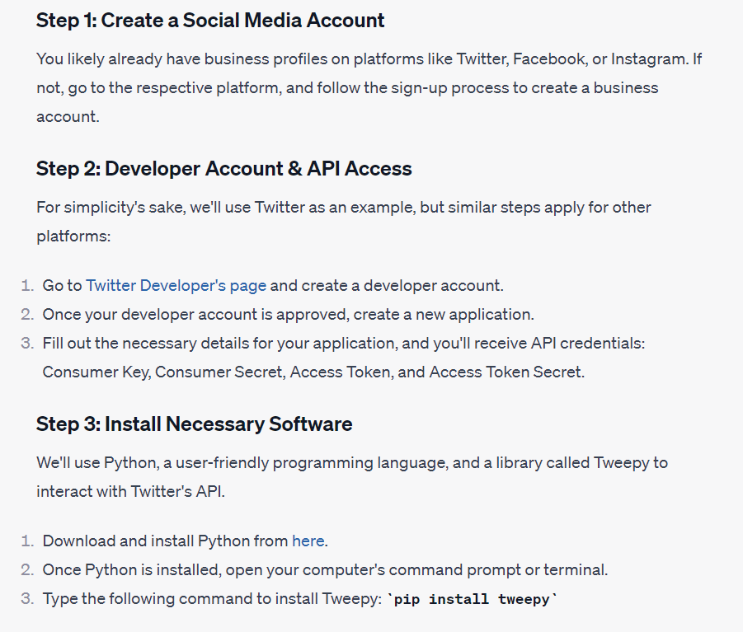
Backup – “Mike’s Cookie Misinformation”

Slide 54
Resources
https://www.prsa.org/article/how-pr-pros-can-help-counter-ai-s-misinformation
https://www.rand.org/pubs/research_reports/RR2314.html
https://www.nsa.gov/Press-Room/Press-Releases-Statements/Press-Release-View/Article/3523329/nsa-us-federal-agencies-advise-on-deepfake-threats/
https://www.wired.com/story/ai-powered-text-program-could-fool-government/
https://www.npr.org/2023/03/23/1165146797/it-takes-a-few-dollars-and-8-minutes-to-create-a-deepfake-and-thats-only-the-sta
https://www.technologyreview.com/2023/06/28/1075683/humans-may-be-more-likely-to-believe-disinformation-generated-by-ai/amp/
https://www.science.org/doi/10.1126/sciadv.adh1850
https://www.airuniversity.af.edu/Portals/10/CASI/documents/Research/Cyber/2023-08-21%20China's%20ChatGPT%20War.pdf
https://insideclimatenews.org/news/31032023/ai-can-spread-climate-misinformation-much-cheaper-and-faster-study-warns/
https://www.politico.com/news/2023/07/17/desantis-pac-ai-generated-trump-in-ad-00106695
https://www.marketingaiinstitute.com/
https://www.oneusefulthing.org/ps://www.science.org/doi/10.1126/sciadv.adh1850

